Slide 1
ecbi
european capacity building initiative
initiative européenne de renforcement des capacités
Enhanced Transparency Framework
Illari Aragon
International Institute for Environmental and Development (IIED)
for sustained capacity building in support of international climate change negotiations
pour un renforcement durable des capacités en appui aux négociations internationales sur les changements climatiques

Slide 2
Transparency: key element of the Paris Agreement. Why?
Foundation of Paris architecture: Countries’ actions take the form of Nationally Determined Contributions (NDCs)
Parties will determine their ambition (bottom-up approach) but need to demonstrate that they are meeting their pledges. Transparency system is crucial to do this.
Transparency system: important to build trust and to hold countries to account.

Slide 3
The Enhanced Transparency Framework “ETF”
(Arts. 13.5 and 13.6 Paris Agreement)
Ensures that countries provide the information necessary to understand actions they are taking to tackle climate change, including on progress towards implementing nationally determined contributions (NDCs) and adaptation actions.
Ensures clarity on the support countries provide and receive, including capacity building, technology transfer and climate finance support for mitigation, adaptation.

Slide 4
ETF key principle: “builds on existing transparency arrangements under UNFCCC” (Arts.13.3, 13.4 Paris Agreement)
What are these arrangements?
National Communications
(every 4 years)
Biennial Update Reports “BURs”
(every 2 years)
GHG National Inventories

Slide 5
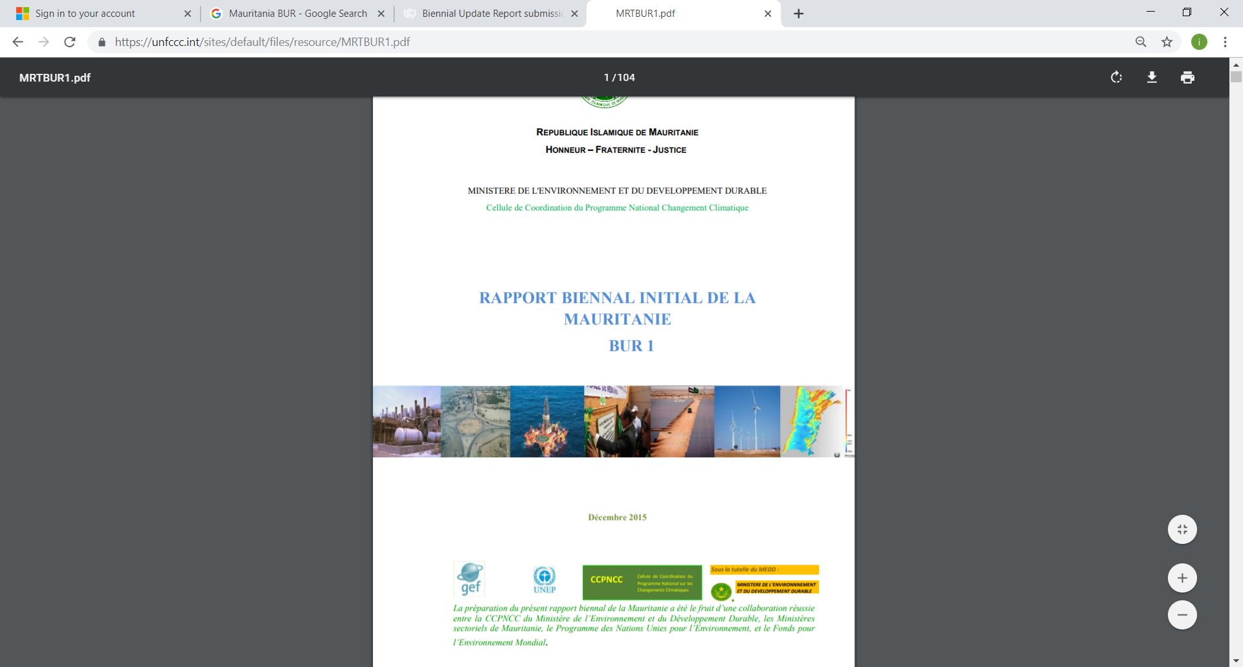
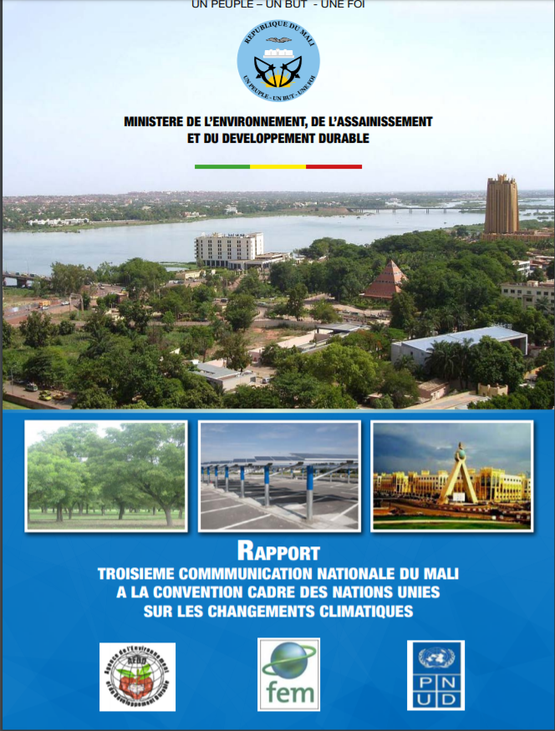

Slide 6
ETF: Reporting obligations (action)
A national GHG inventory report, in accordance with IPCC. All countries to report on this (Shall Art.13.7.a)
Information necessary to track progress made in implementing and achieving NDC under Article 4. All countries to report on this (Shall Art.13.7.b)
Information related to climate change impacts and adaptation under Article 7. Optional for countries to report (Should Art. 13.8)

Slide 7
ETF: Reporting obligations (support)
Financial, technology transfer and capacity-building support provided and mobilised (Shall Art. 13.9)
Financial, technology transfer and capacity building support needed and received (Should Art.13.10)
“Enhanced” Transparency Framework. Why?

Slide 8
How and when will countries report all this information?
Will anyone review it?

Slide 9
National GHG Inventories
Will supersede BURs
Information to track progress of NDC implementation
Biennial Transparency Report “BTR”
Information on climate change impacts and adaptation
Information on support provided and mobilised (finance, tech, cb)
First BTR by 2024 at the latest
Information on support needed and received (finance, tech, cb)

Slide 10
Technical Expert Review (TER)
The Technical Expert Review (TER) is a pillar of the ETF. The TER provides independent and expert verification of countries’ information in their BTRs - regarding mitigation action and support provided.
TER will:
Review consistency of information in accordance with MPGs.
Consider Party’s implementation and achievement of NDC
Identify areas of improvement.
Assist to identify capacity building needs.
TER will not make political judgements, review the adequacy or appropriateness of Party’s NDC.

Slide 11
COP 24 (2018) Katowice, Poland:
Modalities, Procedures and Guidelines “MPGs”
Adoption of “MPGs” often called “transparency guidelines” or “transparency MPGs”.
MPGs provide further guidance on:
GHG inventories (chapter II)
Tracking progress of NDCs implementation (chapter III)
Climate Change impacts and adaptation (chapter IV)
Support provided & mobilised (chapter V)
Support needed and received (chapter IV)
Technical Expert Review (TER) (chapter VI)
Multilateral consideration of progress (FMCP) (chapter VII)

Slide 12
Transparency MPGs: Key features
MPGs are common set of guidance to be followed by all countries but with flexibility approach where needed:
Self-determined by countries
Indicating the use of the flexibility provision
Identifying related capacity constrains
Providing time-frame for improvements
Special consideration to LDCs. May submit the information requested by the ETF at their discretion.

Slide 13
How will it work in practice?
Parties implement NDCs
Parties report progress in BTRs
BTRs reviewed by TER
Improve reporting, encourage ambition
Parties present NDCs
May include adaptation
Every 2 years. Use flexibilities if needed
Makes recommendations
Notes:
2. Parties implement their NDCs: they undertake efforts to meet their targets and implement associate policies and measures, facilitated by support and finance.
3. Parties report on their efforts and progress to the international community.
4. Technical Experts will review these efforts described in BTRs

Slide 14
Reflexion questions
Is the ETF an important element of the international climate change regime? Why?
What are the challenges to implement the ETF in your own country?

