Slide 1
ecbi
Predictability of Climate Finance under the Paris Agreement
Article 9.5 of the Paris Agreement and paragraph 53 of Decision 1/CP.21
Presentation given at the 2018 ecbi Bonn Seminar,
Orlando Rey Santos
Cuba
european capacity building initiative
initiative européenne de renforcement des capacités
for sustained capacity building in support of international climate change negotiations
pour un renforcement durable des capacités en appui aux négociations internationales sur les changements climatiques

Slide 2
Predictability of Climate Finance
Allow long term planning and building scenarios.
Creates trust and confidence among Parties.
Intrinsically linked to the PA Work Programme (PAWP) and the implementation of the PA.

Slide 3
Two pieces of the predictability framework of the PA
Art. 9.5 PA
Ex ante communication
Decision 1/CP 21. Par 54.
New collective goal
Art. 9.5 “Developed country Parties shall biennially communicate indicative quantitative and qualitative information related to paragraphs 1 and 3 of this Article, as applicable, including, as available, projected levels of public financial resources to be provided to developing country Parties. Other Parties providing resources are encouraged to communicate biennially such information on a voluntary”
“… prior to 2025 the Conference of the Parties serving as the meeting of the Parties to the Paris Agreement shall set a new collective quantified goal from a floor of USD 100 billion per year, taking into account the needs and priorities of developing countries”;

Slide 4
Relevance of ex ante communication for predictability .
To know the intended finance flows ahead of time
Consistency and possibility of aggregation between communications
Timeframes for communicating such information allows better planning
The lack of ex ante information impact on the predictability of the NDC and on the intention of enhancing ambition

Slide 5
Relevance of the new collective goal for predictability
To ensure the adequacy and predictability of climate finance.
Differently to the 100 b, this new goal is to be set collectively as a result of a process that include a mechanism to take into account the needs and priorities of developing countries.
Article 2.1.c of the Paris Agreement explicitly states that finance flows have to be made consistent with the global climate goal.
To limit mean temperature increases to “well below 2° C” (referencing also a 1.5° C limit) already means that the scale of finance needed will in fact be much higher
Declaring a number is not enough, the NCG is to come with a clear roadmap.

Slide 6
The need for an early process on the NCG
The extension of the 100b goal to 2025 is already a flexibility from the developing country side in the negotiation of the PA, that is to be honored with an early engagement in the definition of the new goal.
Need to start as soon as possible taking into account the experience with the previous goal, (adopted in Cancun 2010), with several years to translate from a pledge to a roadmap (COP 22 Marrakesh).

Slide 7
Implications of the difficulties of agreeing in a “predictability framework”
In the negotiation process the reluctance to consider a proper framework for ex ante information and to star the consideration of a NCG, may be interpreted as a lack of commitments with the clmate finance itself.
The impression of a lack of commitment around these issues, may compromise reaching the balance outcome on the Paris Programme at COP 24

Slide 8
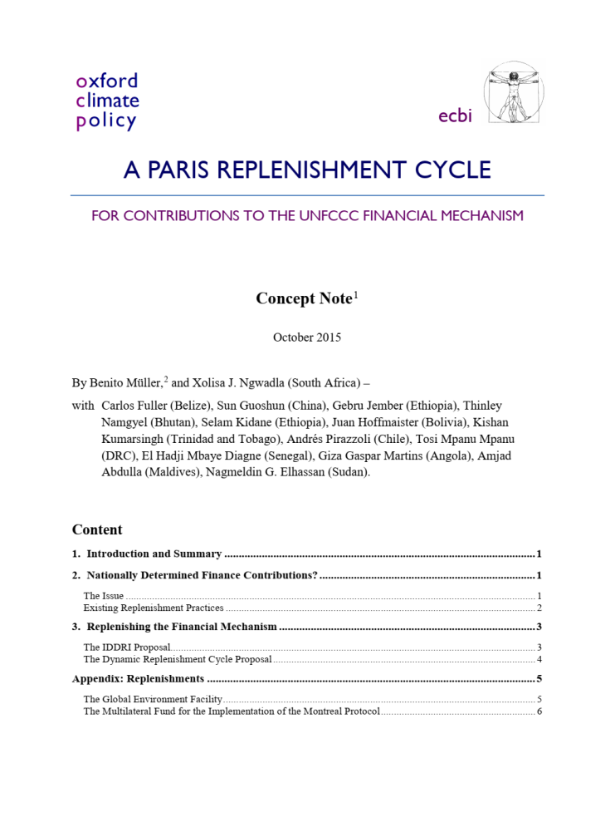
It is possible “to predict” on Finance?
Despite limitations on information available, multi-year commitments ( GEF , GCF) suggest that it is possible to provide indicative information several years into the future, or at least to clarify contributions within defined replenishment cycles.
Some options have been considered in this regard.

