Slide 1
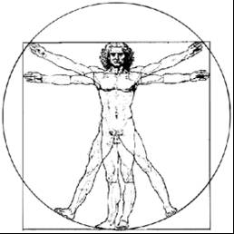
ecbi
Keeping the drumbeat of ambition alive
November Dialogues
Janine E. Felson
Alliance of Small Island States (Belize)
European Capacity Building Initiative Initiative Européenne de Renforcement des Capacités
for sustained capacity building in support of international climate change negotiations
pour un renforcement durable des capacités en appui aux négociations internationales sur les changements climatiques

Slide 2
Anchoring Ambition and Delivering Action 2021
Keeping the 2020 timeline
Submission of NDCs and LEDs (ambition)
Submission of 9.5 Reports (support)
Update on 100 billion (support)
Launching processes for Periodic Review (science)
Pre-2020 Roundtable
Completing unfinished busines
Article 6
Transparency
Long-term finance and 100 billion
Setting the stage for Glasgow
A new collective goal
Common time frame(s)

Slide 3
November Dialogues:
Updates and special events (Broadcast open)
Briefings of the subsidiary bodies and the constituted bodies
Special events of constituted bodies e.g. PCCB, ExCom WIM
Mandated Events (Broadcast open)
Structured Expert Dialogue
Facilitated Sharing of Views (Developing countries inc. China)
Multilateral Assessments (Developed countries inc. EU)
Long-term finance in session workshop
Land Dialogue
Pre 2020 Roundtable
Ocean Dialogue
Informal Consultations (Registration required)
Article 6
Transparency
Common Timeframe(s)

Slide 4
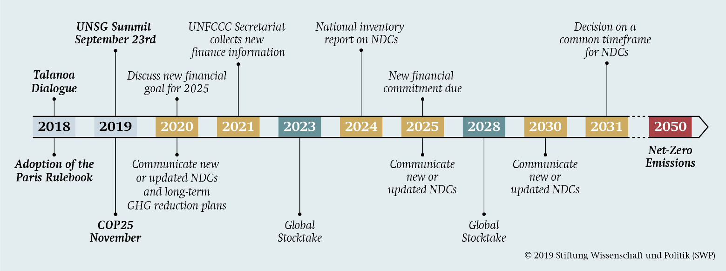
Thank you!

