Slide 1


Funding ‘under the authority and guidance’
Funding NAPAs through CIFs
ECBI Pre-COP Workshop for South and South East Asia Africa Negotiators
Cancun Caribe Park Royal Grand Hotel
26 November 2010
Batu Krishna Uprety
Joint-Secretary (Technical) and Chief
Climate Change Management Division
Ministry of Environment, Government of Nepal

Slide 2
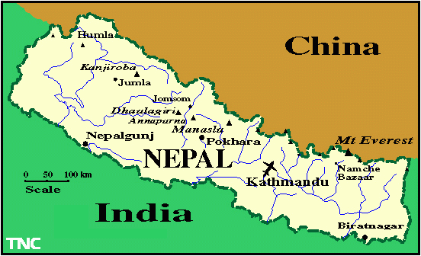
A Snapshot of Nepal

Slide 3
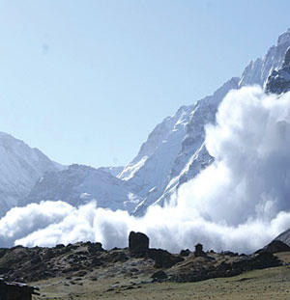

Slide 4
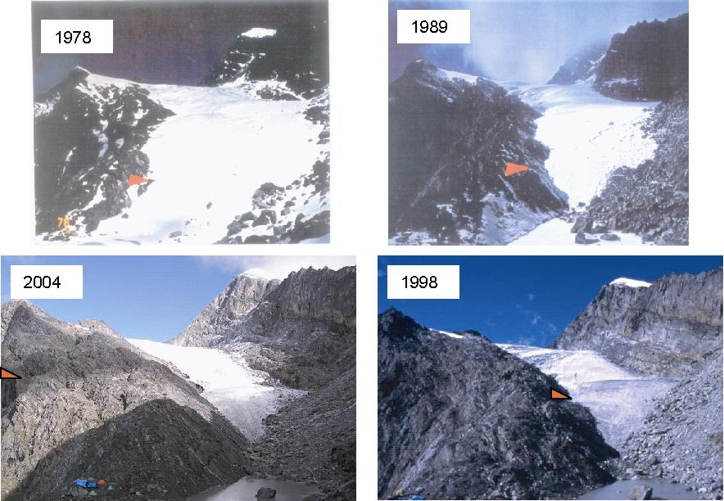
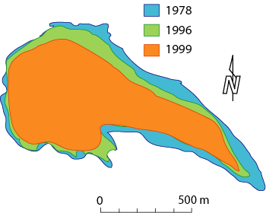
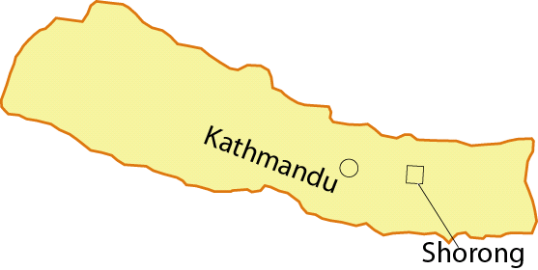

Slide 5
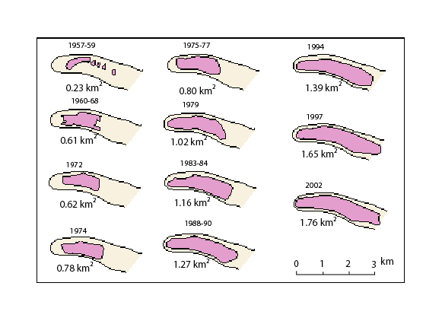
Tsho Rolpa gLACIER – Trend

Slide 6
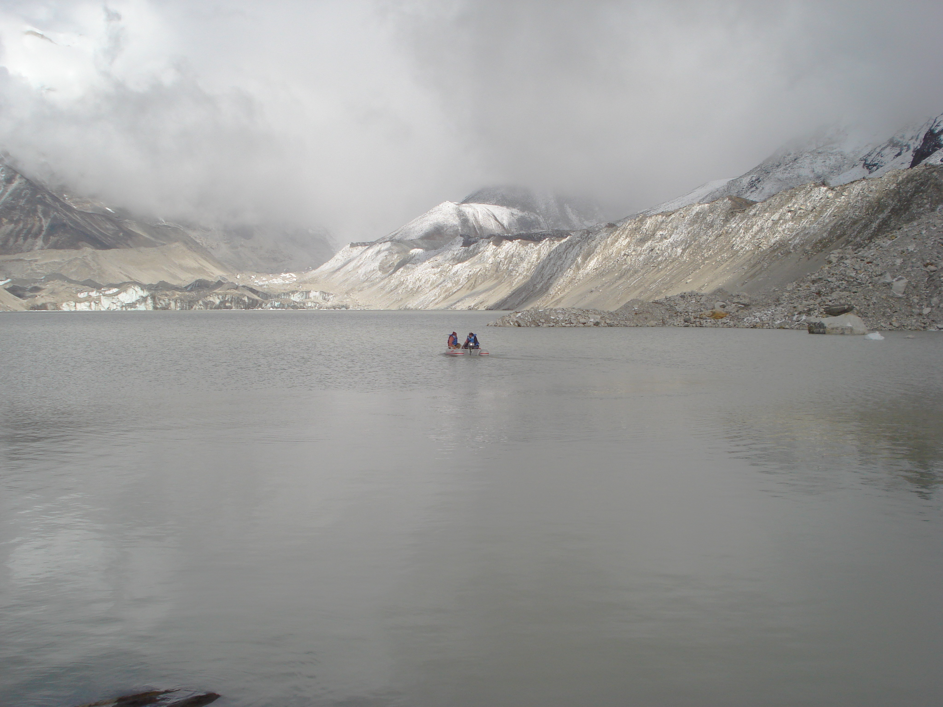
IMJA LAKE

Slide 7
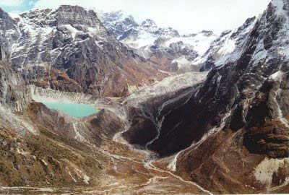
Photo: Lakpa Goeljen Sherpa 1998
(Source: Dwivedi 2003)
Glaciers of Nepal provide an excellent opportunity to study the impact of global climate change in this region.
Photo: Lakpa Goeljen Sherpa 1998
(Source: Dwivedi 2003)
Photo: Clark 1998
(Source: Dwivedi, 2003)

Slide 8
Cimate Change threatens Nepal
Main Rongbuk Glacier (Mount Everest) experienced an average vertical loss of 330 feet between 1921 and 2007
Rate of glaciers retreat is as high as 20 m/year - possibility of 'vertical Tsunami'
Water in Nepal's snow-fed river system increases by about 5.7% till 2030, and decreases by 28% by the end of this century – impacts on water resources projects
Increasing number of 'climate refugees'
1.9 million people vulnerable to climate change with additional 10 million people at climate risks – about 43% of total population under threat
> 7,000 people died in last 10 years due to climate-induced disasters with economic losses of $ 5.34 billion
Impacts on forests, agriculture, health , livelihoods etc.

Slide 9
Nepal’s NAPA Funding
LDC Fund/GEF - US $ 200,000
UK-DFID - US $ 875,000
Royal Danish Embassy - US $ 200,000
UNDP Nepal - US $ 50,000
Total – US $ 1.325 Million
NAPA for urgent and immediate adaption actions
NAPA prepared within 16 months
NAPA Project components
NAPA preparation
Development of knowledge managemenT/learning platform
Development of multi-stakeholder strategy

Slide 10
Funding
Available Funds
Within Convention Regime
LDCF, SCCF &
GEF Trust Fund
AF and SPA
(Strategic Priority for Adaptation)
Outside Convention Regime
UN, EU, MDBs and bilateral
Under the COP authority
CIFs
Co-financing

Slide 11
COP 16 - Finance
Based on negotiating text, possible elements of the Cancun outcome and non-paper
Possibility, in principle, for the establishment of a new fund – ‘balanced approach’, ‘wider outcome’, binding mitigation action for major developing countries etc.
New Fund as an operating entity [of the financial mechanism] of the Convention, under the authority of and accountable to COP, direct access with fiduciary standards etc.

Slide 12
Sample Options
Establish Fund at COP 16, and set up a Standing or Ad-Hoc Committee to design it and report back to COP 17.
Start a process at COP 16 for establishing and designing the Fund
Under the authority of the COP or under a “transitional working group”, and to report back to COP 17 for adoption
Structure should be simple, easy to access and no hurdles etc.

Slide 13
Accessing the Funds
CC – an issue of ‘haves’ and ‘have not’
Accessing funds depends upon needs, perception and understanding – e.g. women cutting rhododendron
Funds - ‘right’ or ‘choice’
Voluntary pledge vs commitment
Little choice of vulnerable community/country
Establishing ‘right’ – long-way to reach destination
Negotiation – long process, empty stomach can’t wait
In principle, focus for under the authority and guidance of and accountable to COP

Slide 14
Nepal’s NAPA Implementation
Nine programmes with US$ 350 million budget
Funding for NAPA implementation as of today
Within Convention regime
LDC Fund (US$ 10 mill) and Adaptation Fund – needs GEF IA and MIE
Outside Convention regime
UK-DFID + EU – Euro 16 million
PPCR (adaptation co-benefits) – US$ 110 million
SREP (adaptation co-benefits) – US$ 40 million

Slide 15
Finance
Translating Commitments into Actions
Technology
Capacity Building
Urgent needs for actions to protect climate vulnerable communities
CIFs (outside regime) – low hanging fruits

