Slide 1

ecbi
Introduction to International Climate Finance
2016 ecbi Regional Workshop for Francophone Africa
Benito Müller
Oxford Climate Policy
european capacity building initiative
initiative européenne de renforcement des capacités
for sustained capacity building in support of international climate change negotiations
pour un renforcement durable des capacités en appui aux négociations internationales sur les changements climatiques

Slide 2
From Rio to Marrakech
1992 Rio Earth Summit: UN Framework Convention on Climate Change (UNFCCC)
Article 11. Financial Mechanism
1. A mechanism for the provision of financial resources on a grant or concessional basis, … is hereby defined. It shall function under the guidance of and be accountable to the Conference of the Parties, … . Its operation shall be entrusted to one or more existing international entities.
1997 Kyoto Protocol (KP)
Article 12. Clean Development Mechanism (CDM)
8. The COP/MOP (CMP) shall ensure that a share of the proceeds from certified project activities is used … to assist developing country Parties that are particularly vulnerable to the adverse effects of climate change to meet the costs of adaptation.
Rio
Kyoto
Buenos Aires
Marrakech
Montreal
Bali
Poznan
Copenhagen
Cancun
Durban
Paris

Slide 3
From Rio to Marrakech
2001. Marrakech Accords
Decision 7/CP.7 Funding under the Convention
2. Decides also that a Special Climate Change Fund (SSCF) shall be established to finance activities, programmes and measures, relating to climate change, that are complementary to those funded by the resources allocated to the climate change focal area of Global Environment Facility and by bilateral and multilateral funding, …;
6. Decides also that a Least Developed Countries Fund (LDCF) shall be established, which shall be operated by an entity entrusted with the operation of the financial mechanism, under the guidance of the Conference of the Parties, to support a work programme for the least developed countries. This work programme shall include, inter alia, national adaptation programmes of action …;
Montreal CMP 1
Rio
Kyoto
Buenos Aires
Marrakech
Nairobi
Bali
Poznan
Copenhagen
Cancun
Durban
Paris

Slide 4
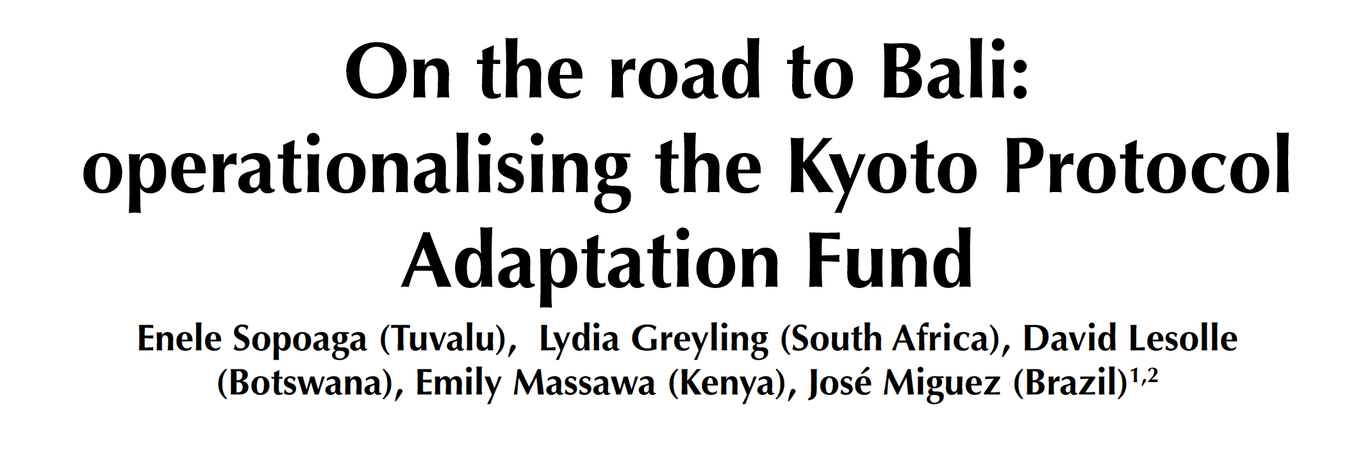
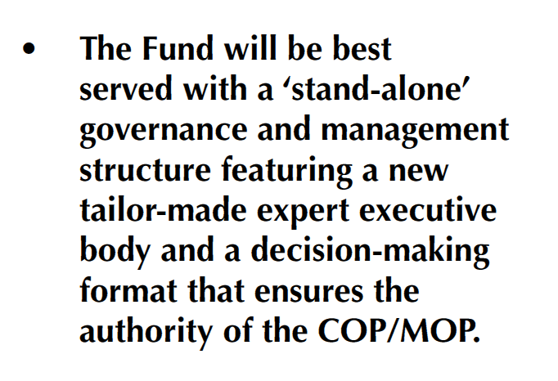


From Marrakech to Cancun
Montreal CMP 1
Rio
Kyoto
Buenos Aires
Marrakech
Nairobi
Bali
Poznan
Copenhagen
Cancun
Durban
Paris

Slide 5
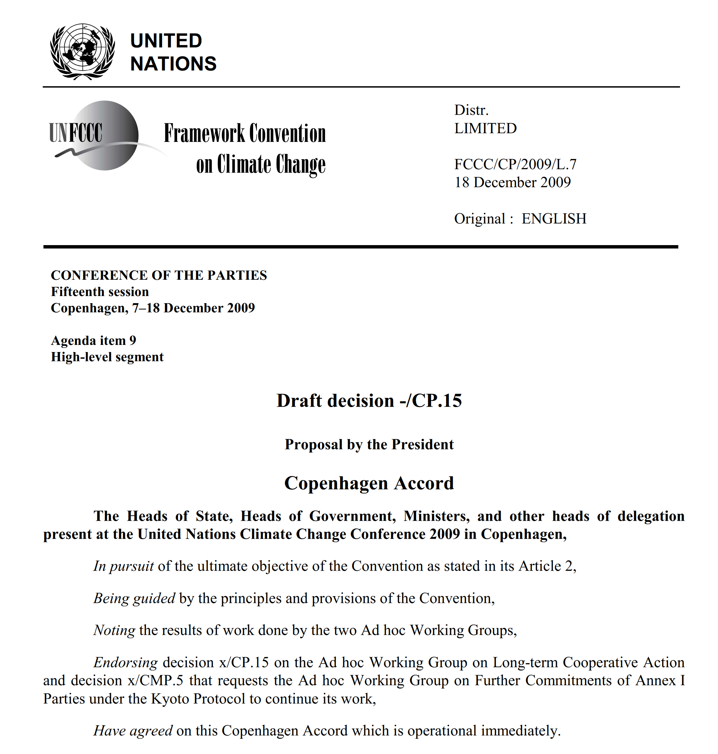
From Marrakech to Cancun
Montreal
Rio
Kyoto
Buenos Aires
Marrakech
Nairobi
Bali
Poznan
Copenhagen

Slide 6
From Marrakech to Cancun
Finance in the Copenhagen Accord
8. Scaled up, new and additional, predictable and adequate funding as well as improved access shall be provided to developing countries,…
Fast-start Finance. The collective commitment by developed countries is to provide new and additional resources, … approaching USD 30 billion for the period 2010 - 2012 with balanced allocation between adaptation and mitigation.
2020 Target. In the context of meaningful mitigation actions and transparency on implementation, developed countries commit to a goal of mobilizing jointly USD 100 billion dollars a year by 2020 to address the needs of developing countries. This funding will come from a wide variety of sources, public and private, bilateral and multilateral, including alternative sources of finance.
10. We decide that the Copenhagen Green Climate Fund shall be established as an operating entity of the financial mechanism of the Convention….
Montreal
Rio
Kyoto
Buenos Aires
Marrakech
Nairobi
Bali
Poznan
Copenhagen

Slide 7
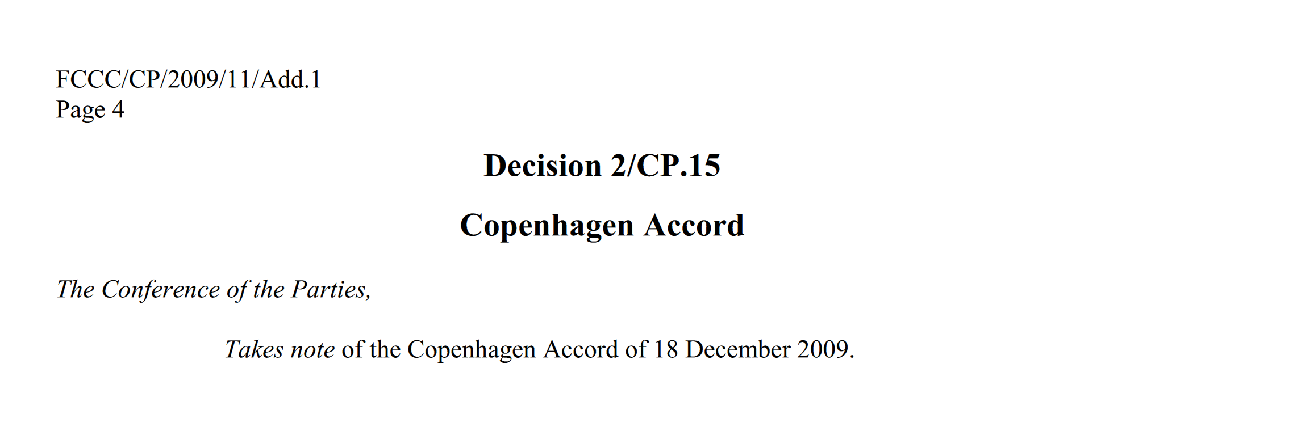
From Marrakech to Cancun
Montreal
Rio
Kyoto
Buenos Aires
Marrakech
Nairobi
Bali
Poznan
Copenhagen

Slide 8
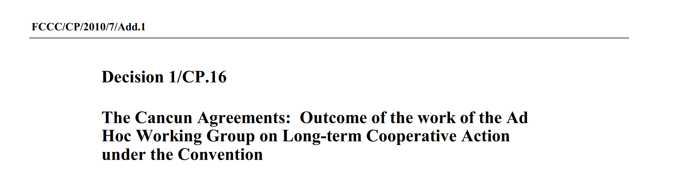
From Marrakech to Cancun
Recognizes that developed country Parties commit, in the context of meaningful mitigation actions and transparency on implementation, to a goal of mobilizing jointly USD 100 billion per year by 2020 to address the needs of developing countries;
Decides to establish a Green Climate Fund, to be designated as an operating entity of the financial mechanism of the Convention under Article 11, …;
Also decides that the Green Climate Fund shall be designed by a Transitional Committee …
Decides to establish a Standing Committee under the Conference of the Parties to assist the Conference of the Parties in exercising its functions with respect to the financial mechanism of the Convention in terms of improving coherence and coordination in the delivery of climate change financing, rationalization of the financial mechanism, mobilization of financial resources and measurement, reporting and verification of support provided to developing country Parties; Parties agree to further define the roles and functions of this Standing Committee
Montreal
Rio
Kyoto
Buenos Aires
Marrakech
Nairobi
Bali
Poznan
Copenhagen
Cancun
Durban
Paris

Slide 9
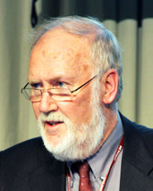
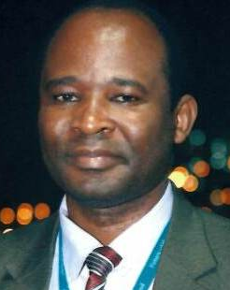
From Cancun to Paris
EDA on the Green Climate Fund
GCFB.8 (Barbados) The Board Requests the Secretariat, under the guidance of the Accreditation Committee and in consultation with relevant stakeholders, to prepare terms of reference for modalities for the operationalization of a pilot phase that further enhances direct access, …, for approval by the Board at its ninth meeting; these terms of reference will launch the pilot phase
Jan Cedergren David Kaluba
Sweden Zambia
Montreal CMP 1
Rio
Kyoto
Buenos Aires
Marrakech
Nairobi
Bali
Poznan
Copenhagen
Cancun
Durban

Slide 10

From Cancun to Paris
GCF Enhanced Direct Access Pilot Phase
Foreign public sector funding stream consolidation through a National Steering Committee (NSC), exercising a National Oversight and Steering Function
In-country devolved access to the provincial and local level for engaging local stakeholders (communities, MSMEs)
Local Provincial National International
Adaptation
NSC
Mitigation
Funding Entity (?)
Financial Intermediary (?)
National Intermediaries
Local Authorities
Local Branches
Community Projects
MSME Projects
Project Implementing Entity
Micro/Small/Medium Executing Entity
Micro/Small Project/Programme
Intermediary

Slide 11
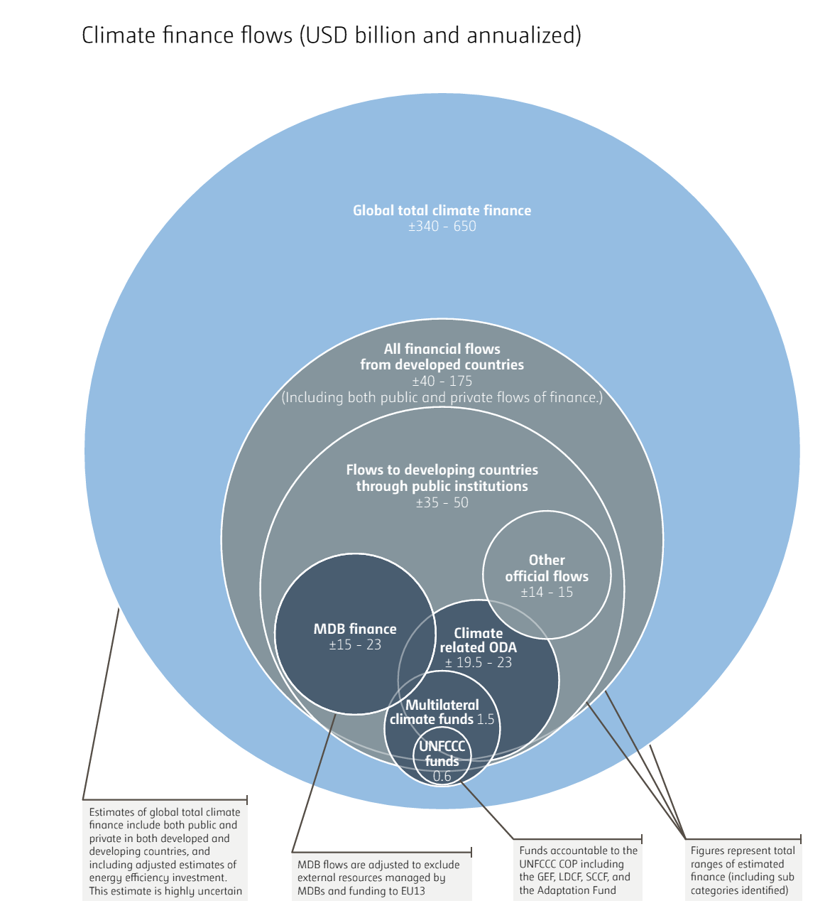
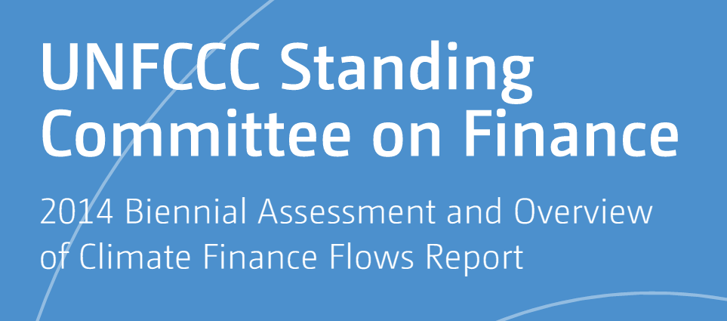
From Cancun to Paris
SCF: Climate Finance Flows Report
Montreal
Rio
Kyoto
Buenos Aires
Marrakech
Nairobi
Bali
Poznan
Copenhagen
Cancun
Durban

Slide 12

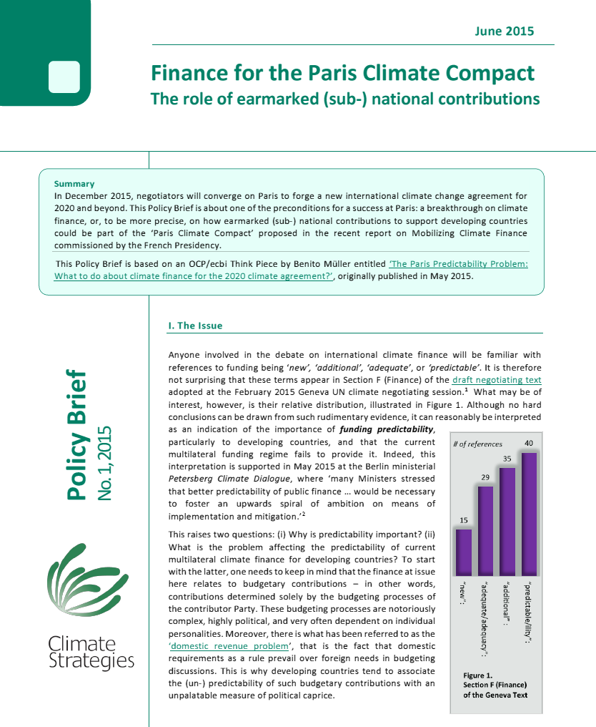
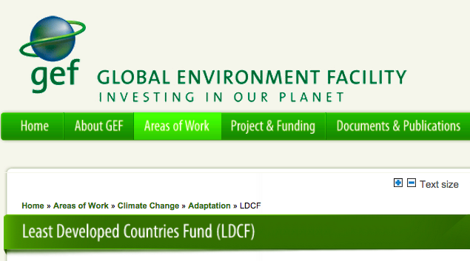
From Cancun to Paris
Enhanced Direct Sourcing of Multilateral Funds
Rio
Kyoto
Buenos Aires
Marrakech
Nairobi
Bali
Poznan
Copenhagen
Cancun
Durban

Slide 13

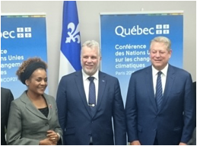

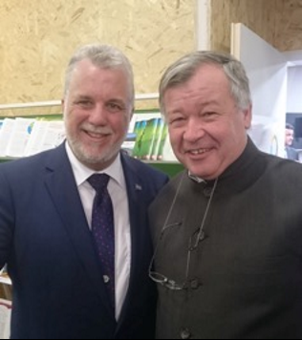
Paris!
Good News for the Future of the LDCF
I. New Business Model
Decision 8/CP.21: Guidance to the GEF
8. Requests the Global Environment Facility to carry out a technical review of the programme priorities of the Least Developed Countries Fund, taking into account the independent review referred to in paragraph 6 above, and to focus the technical review on, inter alia:
Undertaking pilot concrete climate change activities that are particularly relevant for the least developed countries;
Enhancing longer-term institutional capacity to design and execute the activities referred to in paragraph 8(a) above;
II. Expanding the Funding Base
“Paris, 5 December: Today the Chair of the Least Developed Countries (LDCs) Group welcomed a pledge from the Quebec government of $ CAD 6 million to the Least Developed Countries Fund (LDCF). The historic and innovative pledge, made by Philippe Couillard, Premier of Quebec, in the presence of Michaëlle Jean, Secretary General of the Francophonie and Vice President Al Gore, has set a new tone for cooperation and innovative climate financing.”[LDC Group Press Release]
Rio
Kyoto
Buenos Aires
Marrakech
Montreal
Bali
Poznan
Copenhagen
Cancun
Durban
Paris
Notes:
Ad I. Original draft language:
The COP ‘requests the GEF to carry out a technical review of LDCF programming priorities with a view to identifying possible alternative roles for the LDCF in the evolving climate finance architecture, in consultation with relevant stakeholders, particularly the UNFCCC LDC Group, and focus on:
(a) piloting concrete climate change activities particularly relevant for LDCs;
(b) enhancing longer-term institutional capacity to design and execute such activities.’

Slide 14
Finance Outcomes: Paris versus Cancun
Public Sector Finance
Cancun: Takes note of the collective commitment by developed countries to provide new and additional resources, …, approaching USD 30 billion for the period 2010–2012,
Paris: Developed country Parties shall biennially communicate … as available, projected levels of public financial resources to be provided to developing country Parties
Collective Quantified Goals
Cancun: Recognizes that developed country Parties commit, …, to a goal of mobilizing jointly USD 100 billion per year by 2020 to address the needs of developing countries;
Paris: Also decides that, …, developed countries intend to continue their existing collective mobilization goal through 2025 …; prior to 2025 the Conference of the Parties serving as the meeting of the Parties to the Paris Agreement [CMA] shall set a new collective quantified goal from a floor of USD 100 billion per year, taking into account the needs and priorities of developing countries.
Institutional Arrangements
Cancun: Decides to establish a Green Climate Fund, to be designated as an operating entity of the financial mechanism of the Convention
Paris: The Financial Mechanism of the Convention, including its operating entities, shall serve as the financial mechanism of this Agreement.

Slide 15
Collective Quantified Goals
Finance in Paris: Non à la Nouvelle Haute Couture Impériale!
Oxford Climate Policy – the blog
The problem with collective quantified goals for North-South mobilized finance flows relates to what a recent New York Times article described as “Wild West accounting”, namely the fact that there is no, and I fear there will never be, an agreement on how to define/measure them.
I also maintain that the pursuit of such fuzzy targets is extremely unhelpful for the process. All it does is poison the atmosphere and create the opportunity for mutually assured unhappiness, if not acrimony, with one side claiming to have achieved the goal and the other denying it (without a way to verify objectively).
To conclude: we must be humble and discard the emperor’s new clothes (or, in this case, ‘haute couture’) by admitting that the Paris finance outcome was (lamentably) weak, and by stopping to pretend that the ‘Copenhagen narrative’ in terms of targets for mobilised overall financial flows is helpful for the process. Instead we should try and look for ways to genuinely enhance the predictability of public sector contributions to international climate finance.

Slide 16


Alternative Public Sector Finance
… Now it must become ‘de rigueur’!
Oxford Climate Policy – the blog
New York
Massachusetts
California
Share of emission allowance auction proceeds
Share of emission allowances

Slide 17
Alternative Public Sector Finance

Slide 18
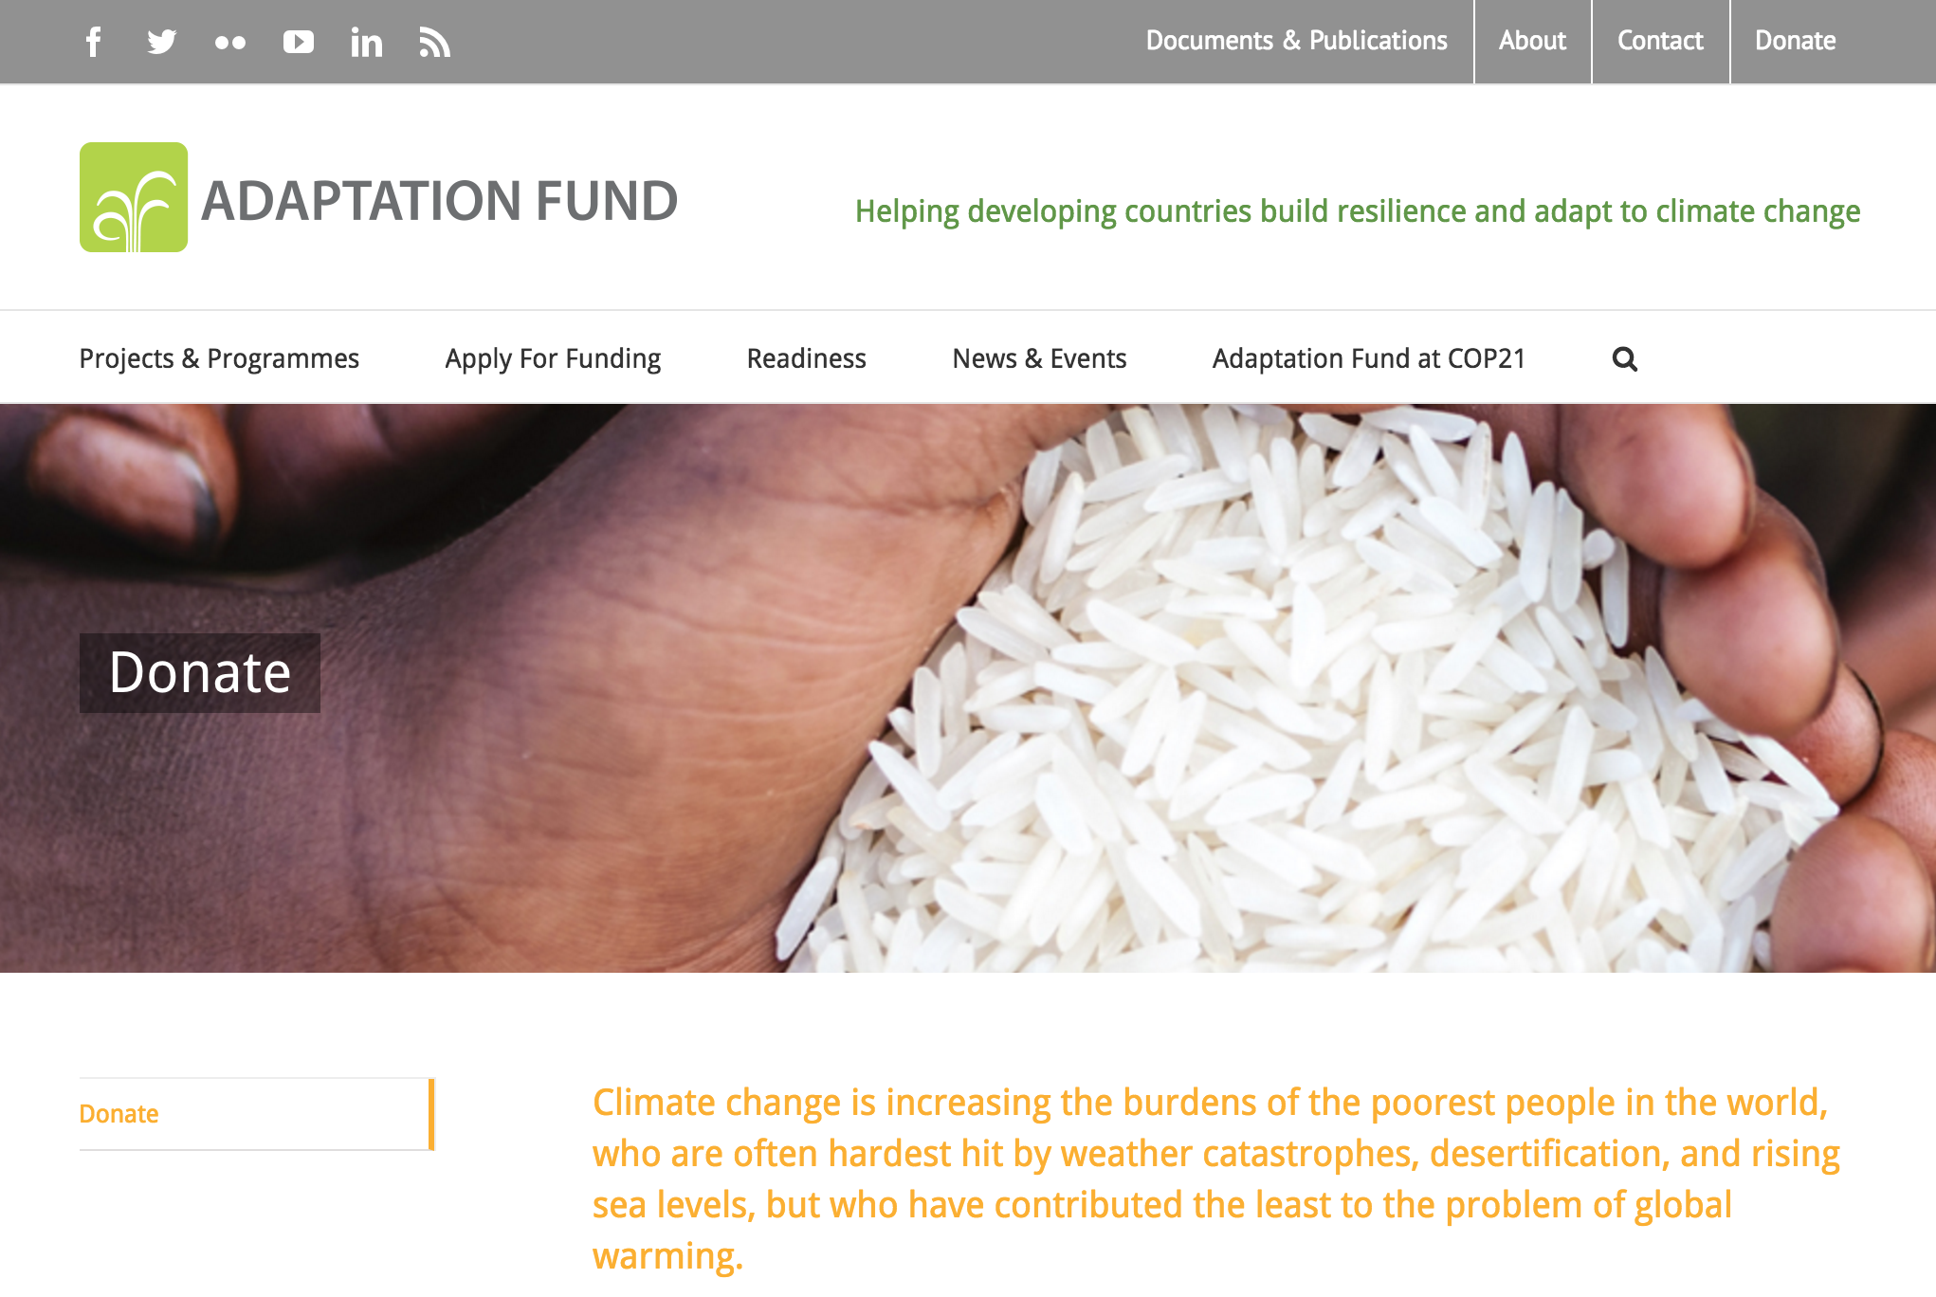
Alternative Public Sector Finance

