Slide 1
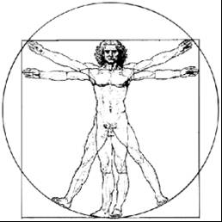
ecbi
GLOBAL STOCKTAKE
ECBI 2017
european capacity building initiative
initiative européenne de renforcement des capacités
for sustained capacity building in support of international climate change negotiations
pour un renforcement durable des capacités en appui aux négociations internationales sur les changements climatiques

Slide 2
Topics Covered
Context of the Global Stocktake
Basic structure of the Stocktake
Key issues for further clarity
Process Model for the Stocktake

Slide 3
Context of the Stocktake
Objective: “periodically take stock of the implementation of this Agreement to assess the collective progress towards achieving the purpose of this Agreement and its long-term goals” Article 14-1
Purpose: “…inform Parties in updating and enhancing, in a nationally determined manner, action and support … enhancing international cooperation for climate action” Article 14-3
Adequacy and Gaps: collective progress is assessed against purpose and goals, hence for mitigation Article 2a & 4-1; Adaptation Article 2b & 7-1; Finance Article 2c & 9
Considerations: “ …a comprehensive and facilitative manner, considering mitigation, adaptation and the means of implementation and support, and in the light of equity and the best available science.” Article 14-1

Slide 4
Basic Structure of the Stocktake
INPUTS | ELEMENTS | OUTPUTS | PURPOSE/OUTCOME
information to determine the benchmark | PROCESS BENCHMARK | understanding of/agreement about the benchmark | Adequacy in relation to the Temperature Goal
 | GAP | estimation of the scale, size, nature of the gap information about options to close the gap … | activities to ultimately enhance ambition and close the gap, equity considerations
information to assess or estimate the current state | CURRENT STATE | estimation of current state in aggregate (collective progress) enhanced understanding/ clarity of individual undertakings (collective undertaking) | activities leading to updating and enhancing of action, support + cooperation
BENCHMARK
PROCESS
PROCESS
PROCESS
GAP
CURRENT STATE
Source: Holz, Ngwadla, 2016

Slide 5
Key issues for further clarity
MEANING OF COLLECTIVE PROGRESS: Different views on whether it is about the assessment targets & transformation vs Assess specific mitigation, adaptation aspects
MEANING OF LONGTERM GOALS: Is the assessment of long-term goals Objectives in 2.1(a-c) OR Objectives including Specific goals, as such 2.1(a-c) 4.1, 7.1, 10.6; how do they get elaborated?
HOW SHOULD THEMES BE ORGANISED: Several Workstream on Mitigation, Adaptation, MoI, -Others, such L&D, RM, etc- OR One workstream addressing all aspects; how do we address cross-cutting issues?
CORE INPUTS: Backward-looking - Forward-looking - Scientific - Equity synthesised information in terms of - who, on what basis, and by when?
MODEL FOR UNDERTAKING THE STOCK-TAKE: See Next slide

Slide 6
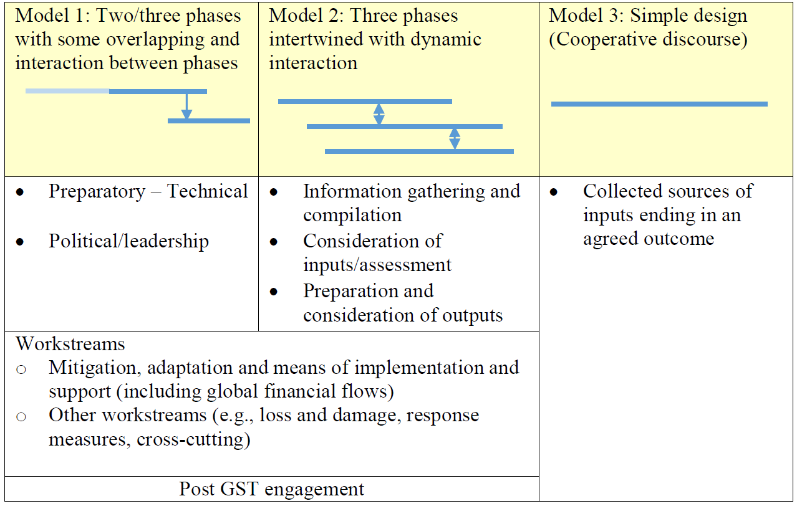
Process model for the Stocktake
Source: APA 1.3 co-facilitator informal note

