Slide 1

ecbi
european capacity building initiative
initiative européenne de renforcement des capacités
The Science of Climate Change
Carlos Fuller, International and Regional Liaison Officer
Caribbean Community Climate Change Centre
for sustained capacity building in support of international climate change negotiations
pour un renforcement durable des capacités en appui aux négociations internationales sur les changements climatiques

Slide 2
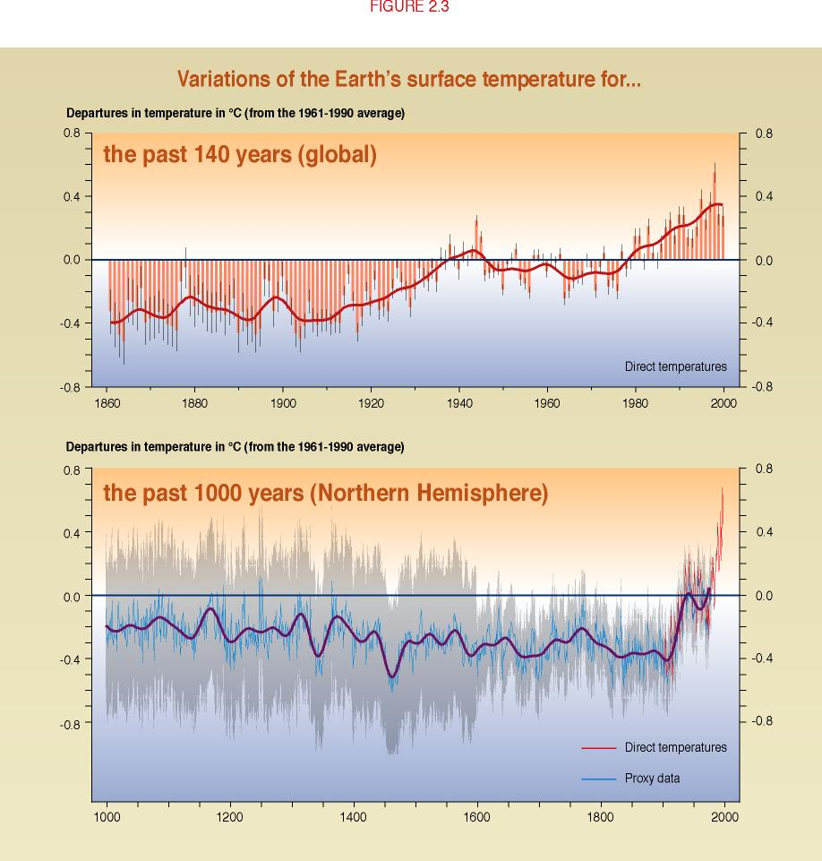
Global mean surface temperatures have increased
IPCC

Slide 3
Analysis by the National Meteorological Service of Belize

Slide 4
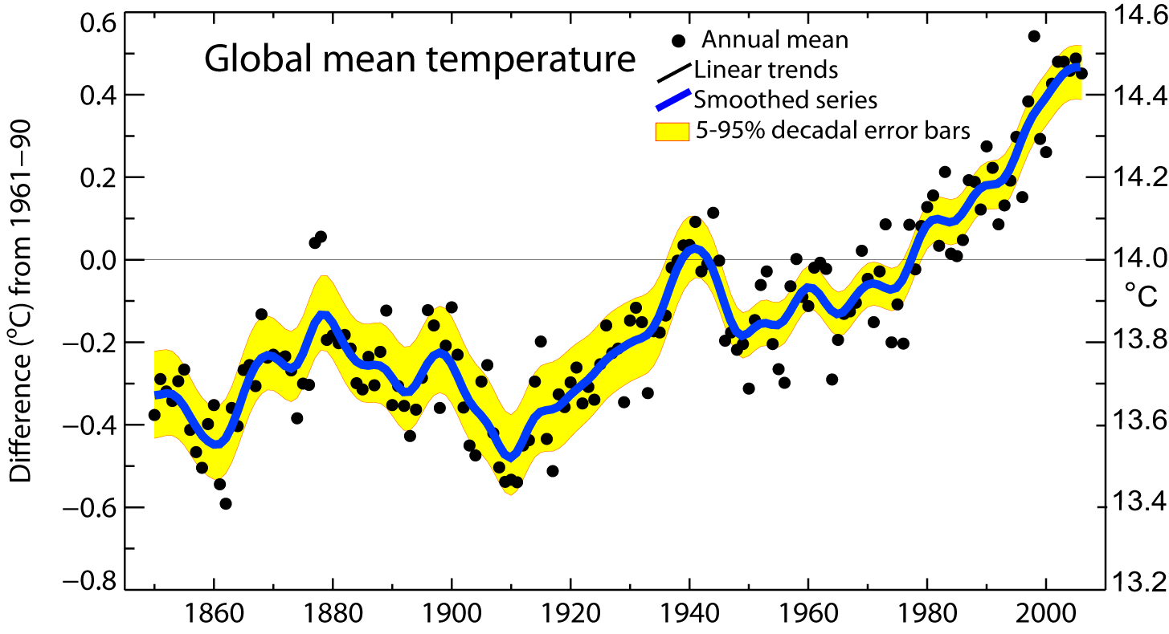
Global mean temperatures are rising faster with time
Warmest 10 years: 1998, 2009
2013, 2005, 2010, 2014,2018 2017, 2015, 2016
Period Rate
Years °/decade
50 0.128±0.026
100 0.074±0.018
IPCC

Slide 5
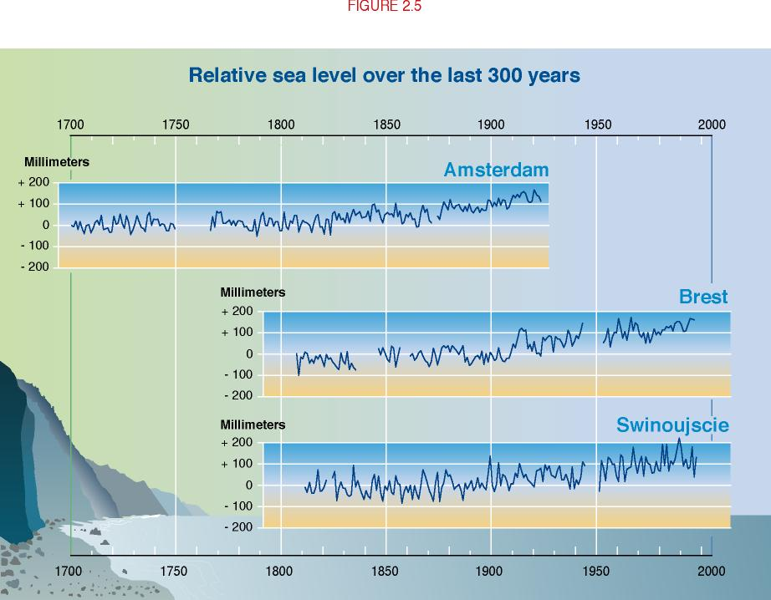
Sea Levels have risen
IPCC

Slide 6
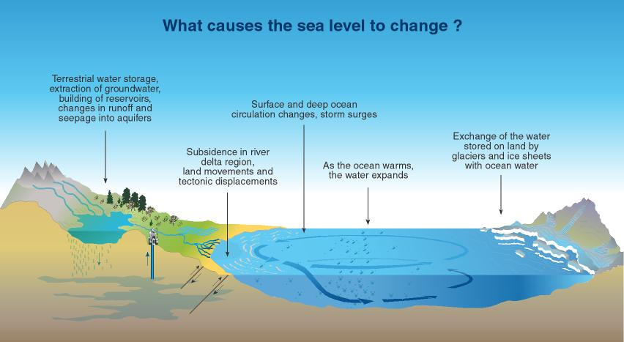
The projected sea level change
IPCC

Slide 7
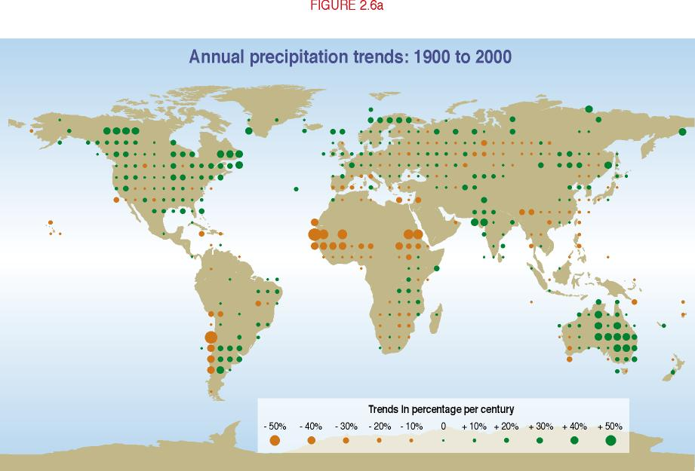
Precipitation patterns have changed
IPCC

Slide 8
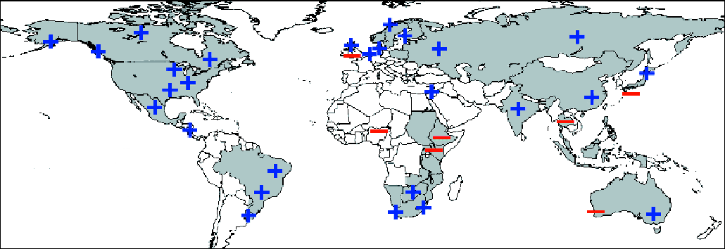
Proportion of heavy rainfalls: increasing in most land areas
IPCC

Slide 9
Changes in Rainfall Intensity
Saint Lucia Example
More intense extreme events (storms and droughts)
2009-2010-worst drought in Saint Lucia in 40 years!
Hurricane Tomas in Saint Lucia in 2010 produced 25” of rainfall in some areas in 24 hours!

Slide 10
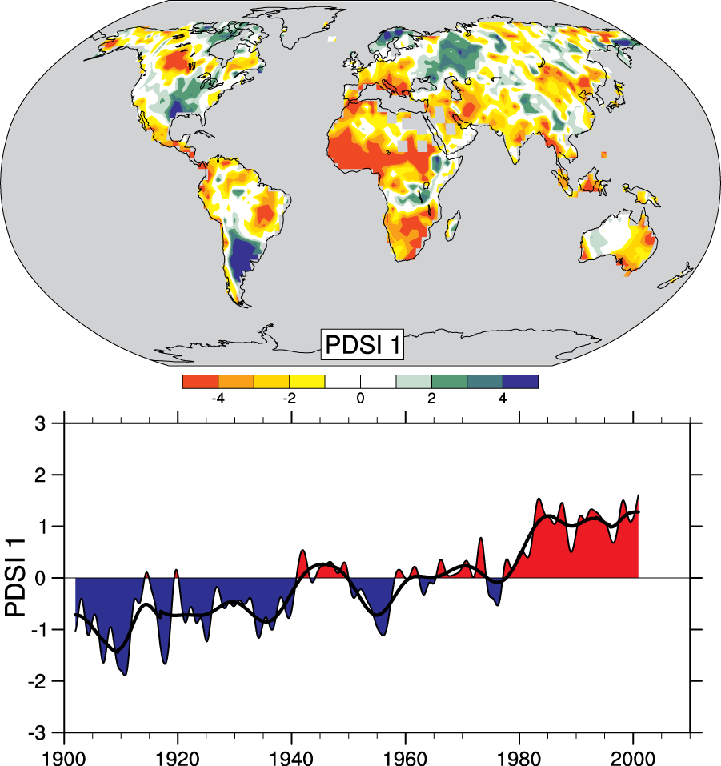
Drought is increasing most places
Mainly decrease in rain over land in tropics and subtropics, but enhanced by increased atmospheric demand with warming
The most important spatial pattern (top) of the monthly Palmer Drought Severity Index (PDSI) for 1900 to 2002.
The time series (below) accounts for most of the trend in PDSI.
IPCC

Slide 11
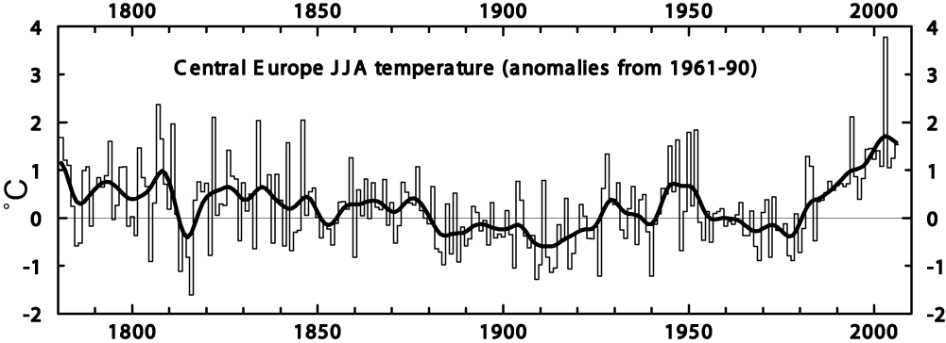
Heat waves are increasing: an example
Extreme Heat Wave
Summer 2003
Europe
IPCC

Slide 12
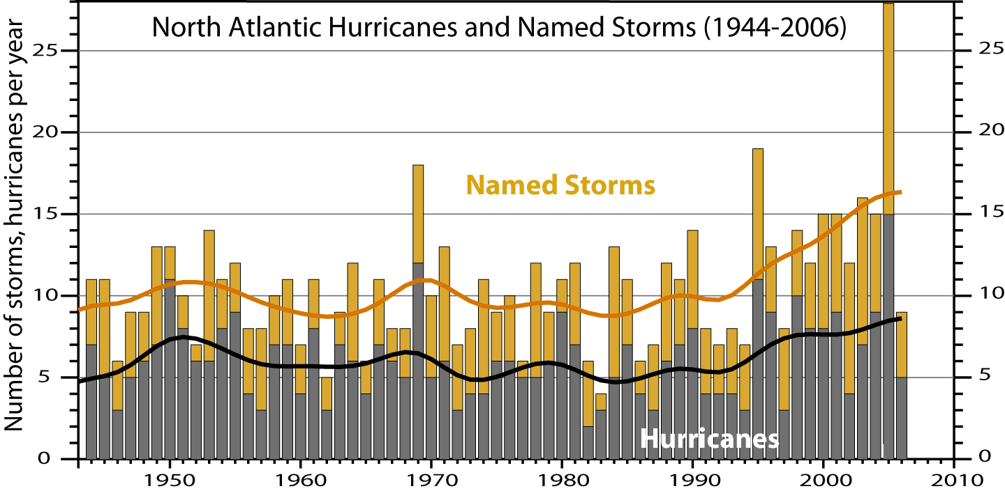
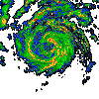
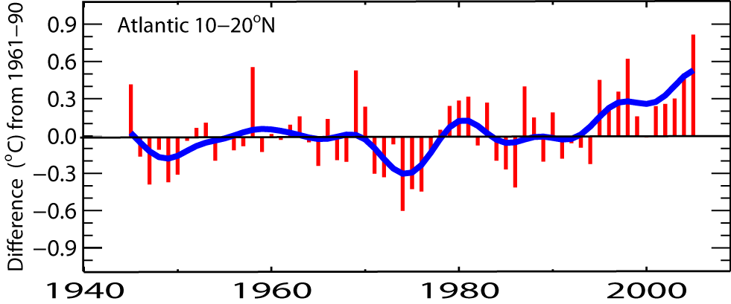
North Atlantic hurricanes have increased with SSTs
N. Atlantic hurricane record best after 1944 with aircraft surveillance.
Global number and percentage of intense hurricanes
is increasing
Marked increase after 1994
(1944-2005)
SST
IPCC

Slide 13
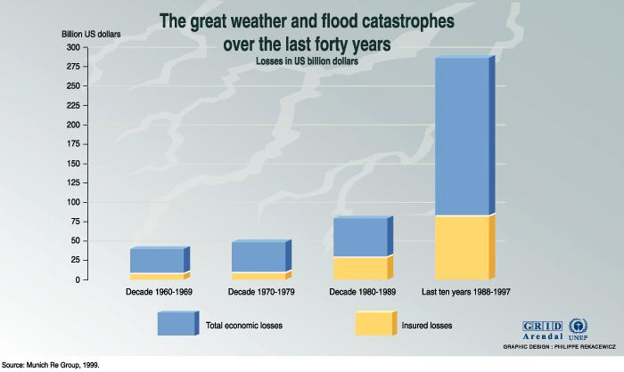
Weather-related economic damages have increased

Slide 14
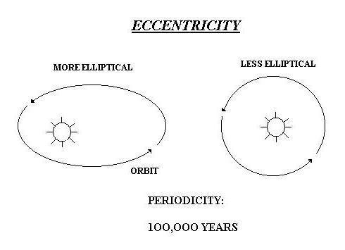
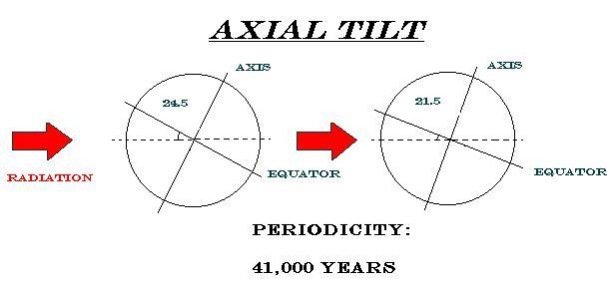
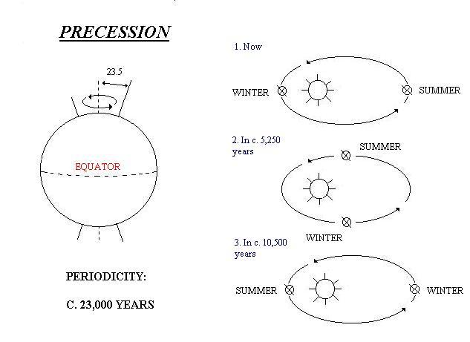
Main Drivers in Natural Climate Change – Long Term
The Sun - Source of Heat Energy in Earth Atmosphere System – Solar Constant not Changing – Annual Solar Radiation Amount Entering Atmosphere Not Changing
Earths Rotation – Milutin Milankovitch
  Orbital Eccentricity – Shape of Orbit changes during a cycle of 100K years from Near Circular to Elliptical and back
  Tilt of Axis of Rotation today about 23.5 deg But in a Cycle of 41K years Varies Between 21.5 – 24.5 deg
  Precession – Earths Axis Wobbles like a Spinning Top – Points to Different Spots in Sky during Cycle of 23 - 26K years
Chronology of Temp Change Established for 450K years through Oxygen Isotope Analysis & Statistical Analysis of Climate Sensitive Organisms show Good Correlation with above Three Processes
Notes:
Climate Change is a natural process and the earth undergoes what we refer to as natural climate variability- periods of cooling & warming. We are presently in a an interglacial period where the large ice cover of the past have melted due to natural warming of the earth. The accompanying slide explains the causes of natural climate change from the theory put forward by Serbian Mathematician Milutin Milancovitch

Slide 15
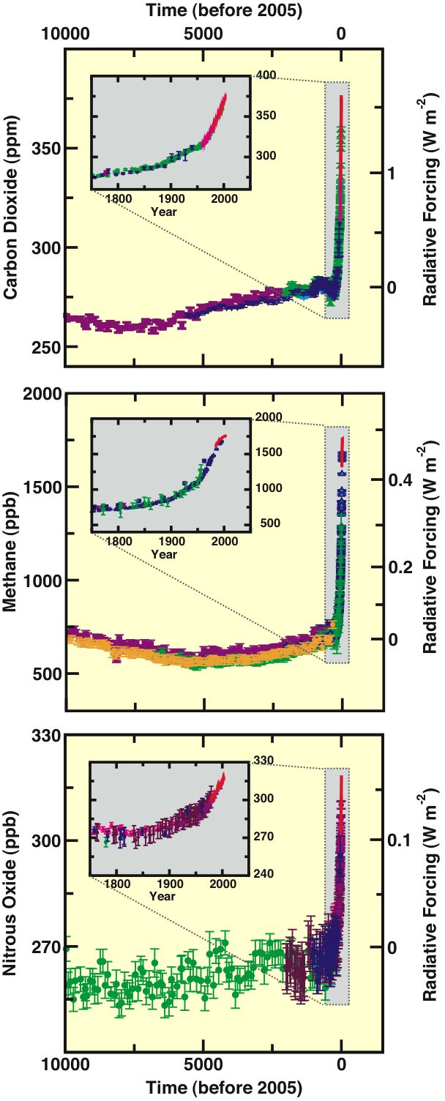
Human and Natural Drivers of Climate Change
CO₂, CH₄ and N₂O Concentrations
- far exceed pre-industrial values
- increased markedly since 1750
due to human activities
Relatively little variation before
the industrial era
IPCC

Slide 16
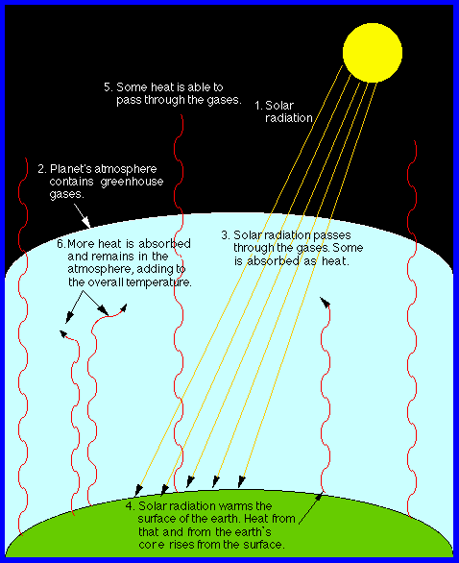
IPCC

Slide 17
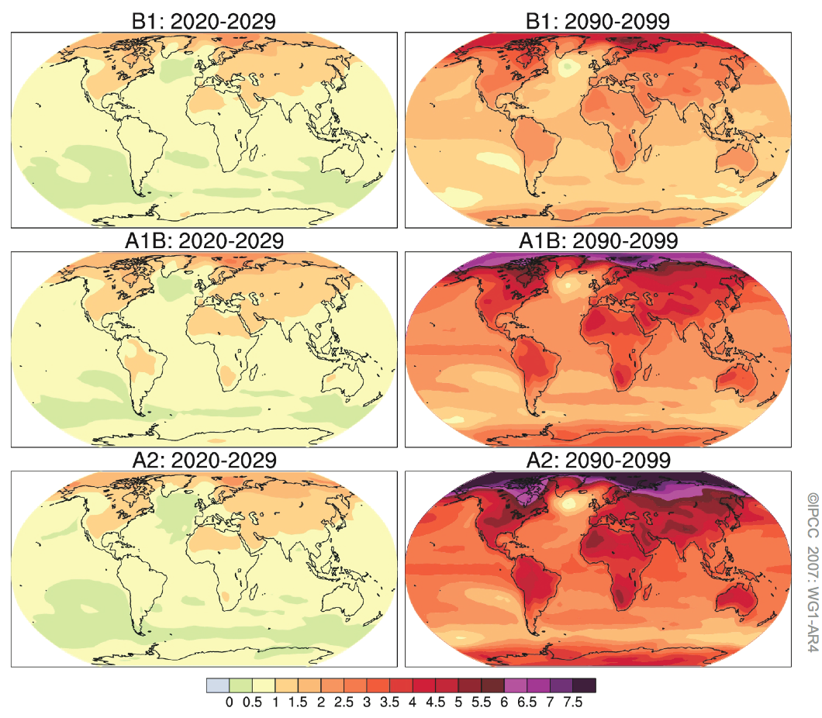
Projections of Future Changes in Climate
Projected warming
in 21st century
expected to be
greatest over land
and at most high
northern latitudes
and least over the
Southern Ocean
and parts of the
North Atlantic
Ocean
IPCC

Slide 18
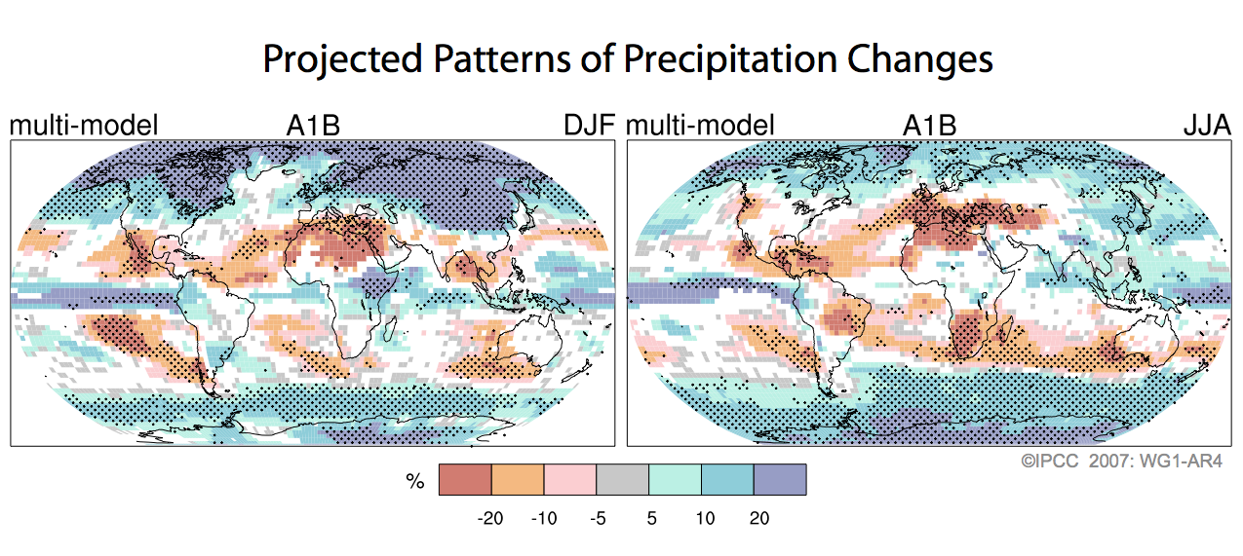
Projections of Future Changes in Climate
Drying across the tropics: wetter in polar regions
IPCC

Slide 19
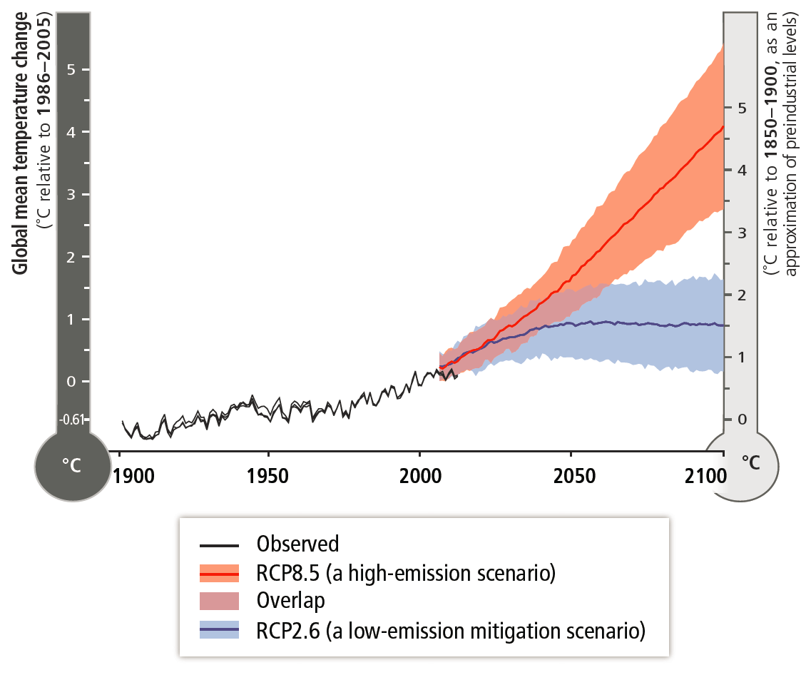
WGI AR5 - Temperature Projections
“Without additional mitigation… global mean surface temperature increases in 2100 from 3.7 to 4.8°C compared to pre‐industrial levels”
  - warming possible up to 7.8°C when including climate uncertainty.
IPCC

Slide 20
IPCC

Slide 21
Results from the Regional PRECIS Model
Mean changes in the annual surface temperature for period 2071-2099
ECHAM 4- A2
HADCM3 – A2
Annual warming of between 1°C and 5°C by the 2080s
Greater warming in the NW Caribbean (Jamaica, Cuba, Hispaniola, Belize) than in the eastern Caribbean
Greater warming in the summer months than in the cooler and traditionally drier months of the year
ECHAM 4 – B2
HADCM3 – B2

Slide 22
Annual mean changes in precipitation (%) for 2071-2099
Results from the Regional PRECIS Model
A drier Caribbean except for western Cuba , south Bahamas, Costa Rica and Panama
A pronounced north/south gradient in rainfall change during the dry season (January to April)
Wet season becoming drier
ECHAM4 – A2
HADCM3 – A2
ECHAM4 – B2
HADCM3 – B2

Slide 23
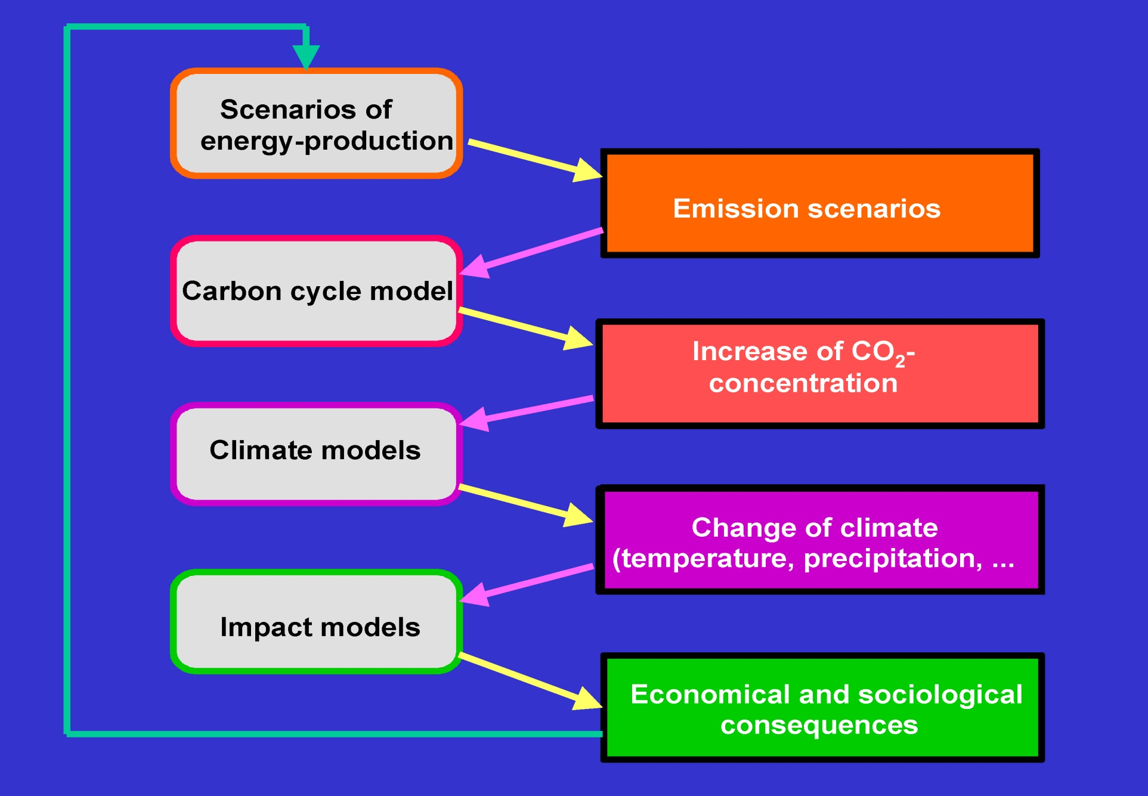
The information chain leading to a climate projection
IPCC

Slide 24
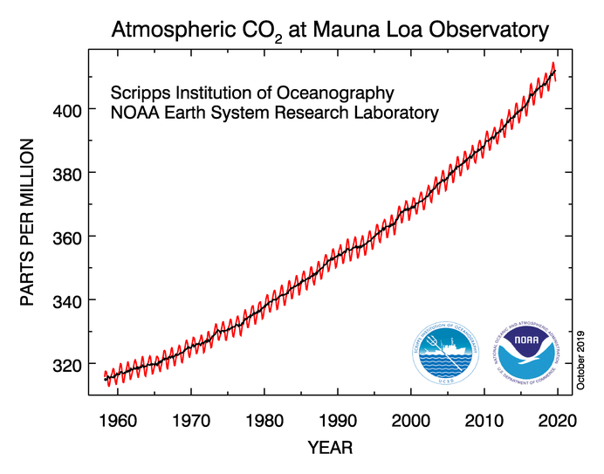

Slide 25
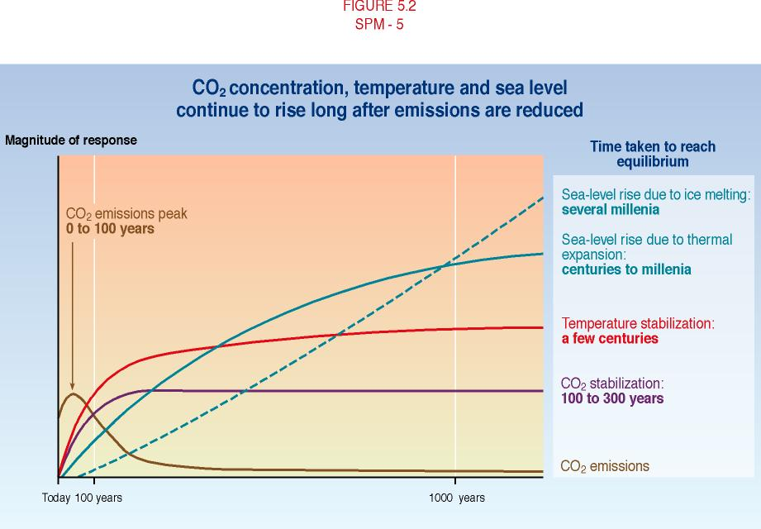
CO₂ concentrations, temperature and sea level continue to rise long after emissions are reduced
IPCC

Slide 26
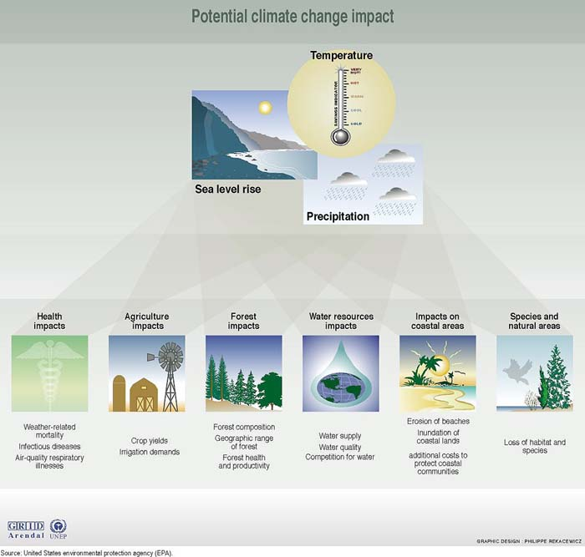
More adverse than beneficial impacts on biological and socioeconomic systems are projected

Slide 27
Sea Levels have risen
Guyana:
Sea level rise is 5 times greater than global avg.
  10.2 mm per year from 1951-1979
IPCC

Slide 28
Impacts of 1m SLR for CARICOM
Over 2,700 km² land area lost (10% of The Bahamas) valued at over US$70 billion
Over 100,000 people displaced (8% of population in Suriname, 5% of The Bahamas, 3% Belize)
  Cost to rebuild basic housing, roads and services (water, electricity) for displaced population approximately US $1.8 billion
Annual GDP losses of US $1.2 billion (over 6% in Suriname, 5% in The Bahamas, 3% in Guyana and Belize)
At least 16 multi-million dollar tourism resorts lost, with a replacement cost of over US $1.6 billion and the livelihoods of thousands of employees and communities affected
Over 1% agricultural land lost, with implications for food supply and rural livelihoods (4% in Suriname, 3% in The Bahamas, 2% in Jamaica)
Transportation networks severely disrupted
  Loss of 10% of CARICOM island airports at a cost of over US $715 million
  Lands surrounding 14 ports inundated (out of 50) at a cost of over US $320 million
  Reconstruction cost of lost roads exceeds US $178 million (6% of road network in Guyana, 4% in Suriname, 2% in The Bahamas)
Total Economic Impact:
  GDP loss = > US $1.2 billion per year (cumulatively US $30 billion if 1m SLR occurs in 2075)
  Permanently lost land value = US $70 billion
  Reconstruction / relocation costs = $4.64 billion

Slide 29
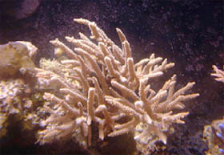

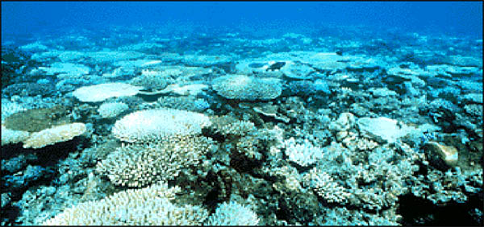
Coral bleaching events are increasing & are expected to increase even further

Slide 30
Caribbean Coral Reefs
Increased thermal stress on Caribbean coral reefs in the next 20-30 years inevitable due to “committed” warming from GHG emissions already in the atmosphere
Under either the 1.5°C or 2°C warming scenarios, thermal stress on Caribbean coral reefs far exceeds current mass coral bleaching thresholds
Adaptation may allow some Caribbean coral reefs to avoid severe degradation from frequent bleaching events up to a 1.5C warming
Ocean chemistry changes anticipated when warming of 1.5°C above pre-industrial levels occurs (i.e., ~490 ppm atmospheric CO2) may remain adequate for reef growth, whereas at 2.0°C and 550 ppm Caribbean reefs may erode faster than they are built
Climate change and ocean acidification at 1.5°C will significantly degrade Caribbean coral reef ecosystems and the services they provide. This will be even more severe at 2.0°C. Beyond 2.0°C many Caribbean coral reefs will not survive.
The ecosystem services (fisheries and tourism) provided by coral reefs in the Caribbean are valued at between US $1.5 billion and 3.5 billion per annum.

Slide 31

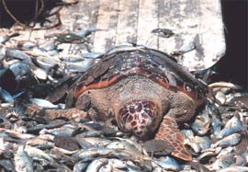
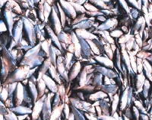
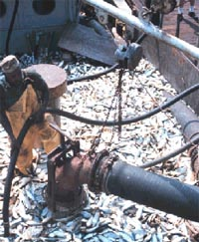
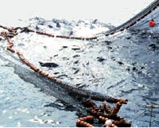
Fisheries
Threatened:
-Loss of habitats
mangroves, reefs
-Species migrate
-Water quality changes

Slide 32
Yellow tail
Ocyurus chrysurus
Conséquences du réchauffement sur la biodiversité marine exploitée et impacts sur les pêcheries
Fabian BLANCHARD, Chercheur écologue halieute - Institut Française de Recherche pour l'Exploitation de la Mer (IFREMER - Guyane)
Habitat becomes less favourable
+1°C

Slide 33
Vulnerability Studies in Belize
PRECIS, DSSAT4 and Cropwat
Sugarcane and Citrus
2028 & 2050
1 & 2.5°C rise in temp
± 12 & 20% change in precipitation
Result: 12-17% decline in yields for sugarcane
Result: 3 – 5% decline in yields for citrus
DSSAT
Ministry of Agriculture & National Met. Service
Beans, corn and rice
2°C rise in temp, ±20% change in precipitation
Rain fed, no CO₂ fertilization
Result: 14- 19% decline in yield for beans
Result: 10 - 14% decline in yield for rice
Result: 22 – 17% decline in yield for corn

Slide 34
Forestry Threatened
Belize: 1999-2000
High temperatures & low humidity
Pine bark beetle infestation
75% of nation’s pine forest destroyed
Poor forest management
Climate change
Impacts on timber industry and biodiversity
Contributed to emissions of GHGs
Increased erosion – poor water quality (rivers and sea)
Higher temperatures
Lower humidity
More forest fires
More pests and diseases

Slide 35
The international response to climate change?
The United Nations Framework Convention on Climate Change (UNFCCC)!
The subject of the next session…
UNFCCC Climate Dialogues (23 November to 3 December 2020)

Slide 36
SBSTA Research Dialogue
  Science for global net-zero: Updates on science and enhancing understanding to accelerate mitigation and adaptation
  24 & 25 November
  Theme 1: Updates on advancements in research and modelling
  Theme 2: Factors for enhancing understanding to accelerate adaptation and mitigation

Slide 37
First meeting of the structured expert dialogue (SED 1) on the second periodic review
26 & 27 November 2020
IPCC Experts
  Overview of new knowledge on the LTGG emerging form the IPCC 2018-19 Special Reports
  Scenarios compatible with the LTGG considered in the IPCC 2018-19 special reports
  Information and knowledge gaps addressed in the IPCC 2018-19 Special Reports with regard to scenarios to achieve the LTGG and the range of associated impacts
  Challenges and opportunities for achieving the LTGG, as identified in the IPCC 2018-19 Special Reports

Slide 38
Earth Information Day
30 November
Updates on the state of the global climate system and its observation (including imprints of Covid-19)
Recent advances in Earth observation technology and data processing to support decision making

Slide 39
Dialogues based on IPCC Special Reports
Dialogue on the relationship between land and climate change adaptation related matters
  30 November & 1 December 2020
Ocean and Climate Change Dialogue to consider how to strengthen adaptation and mitigation action
  2 & 3 December 2020

