Slide 1
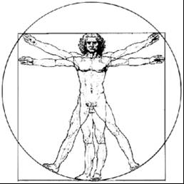
ecbi
Becoming a UNFCCC delegate:
What you need to know
Stella Gama
Malawi
Janna Tenzing
International Institute for Environment and Development
european capacity building initiative
initiative européenne de renforcement des capacités
for sustained capacity building in support of international climate change negotiations
pour un renforcement durable des capacités en appui aux négociations internationales sur les changements climatiques

Slide 2
I. Understanding the UNFCCC

Slide 3
Why is a multilateral process to address climate change necessary?

Slide 4
Climate change treaties
1992: United Nations Framework Convention on Climate Change (UNFCCC)
197 Parties to the Convention = Conference of the Parties (COP); entered into force in 1994
1997: Kyoto Protocol (KP)
192 Parties to the Kyoto Protocol = Conference of the Parties serving as the Meeting of the Parties to the Kyoto Protocol (CMP); entered into force in 2005
2015: Paris Agreement
185 Parties to the Paris Agreement = Conference of the Parties serving as the Meeting of the Parties to the Paris Agreement (CMA); entered into force in 2016

Slide 5
UNFCCC (1992)
The ultimate objective of this Convention… is to achieve… stabilisation of greenhouse gas concentrations in the atmosphere at a level that would prevent dangerous anthropogenic interference with the climate system.
Such a level should be achieved within a time-frame sufficient to allow ecosystems to adapt naturally to climate change, to ensure that food production is not threatened and to enable economic development to proceed in a sustainable manner.
Article 2, UNFCCC

Slide 6
Key principles
Common but differentiated responsibilities and respective capabilities (CBDR-RC)
Equity
Specific needs and special circumstances of developing countries
Inter-generational equity
Precaution and prevention
→ Timely action on CC even under conditions of scientific uncertainty
Sustainable development

Slide 7
Kyoto Protocol (1997)
Commits developed country Parties to reduce GHG emissions by an average of 5% below 1990 levels during first commitment period (2008-2012);
Further reductions in second commitment period (2013-2020)

Slide 8
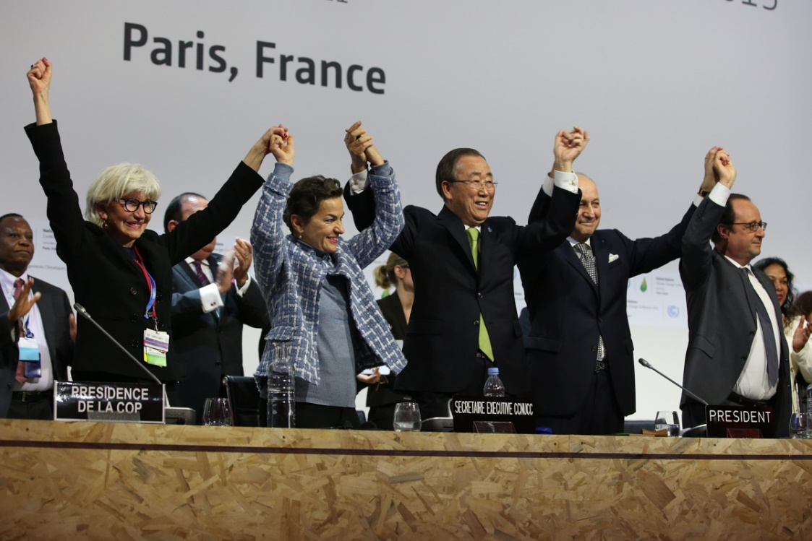
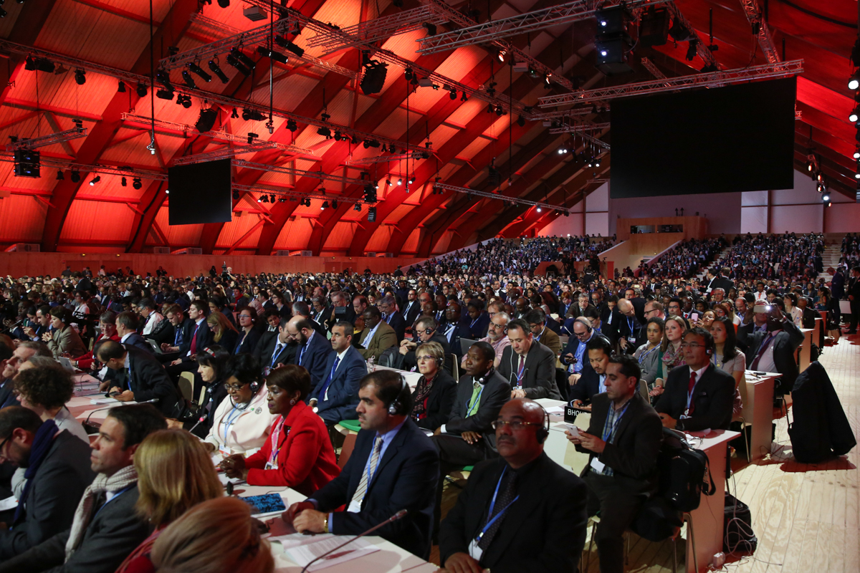
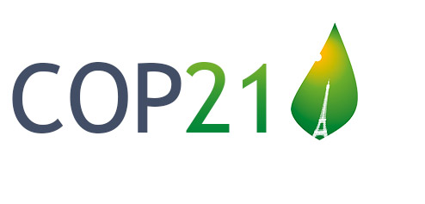
Paris Agreement (2015)
Universal
Legally binding
Comprehensive, balanced
Bottom-up action
Built-in ambition mechanism
Long-Term goal
Photos by IISD/Kiara Worth

Slide 9
Paris Agreement (2015)
…aims to strengthen the global response to climate change, including by:
Holding global average temperature increase to well below 2ºC, aiming for 1.5ºC
Increasing the ability to adapt and foster low-carbon, climate-resilient development
Making finance flows consistent with low-carbon and climate-resilient development pathways
Article 2, Paris Agreement

Slide 10
II. What’s at stake

Slide 11
Where are we
Since pre-industrial times, human activities have caused approximately 1.0°C of global warming.
Already seeing consequences for people, nature and livelihoods
At current rate, would reach 1.5°C between around 2030 and 2050
National pledges are not enough to limit warming to 1.5°C
• Avoiding warming of more than 1.5°C would require carbon dioxide emissions to decline substantially before 2030
Close emission gap
Notes:
Recall the objective of the Convention and Paris Agreement

Slide 12
Emergence and intensity of regional climate change hot spots West African and the Sahel
Source: IPCC SR1.5
Warming of 1.5°C or less
Warming of 1.5ºC-2°C
Warming > 2°C
Hot nights, longer, more frequent heat waves: Likely Increase;
L further Incr.; VL substantial Incr.
Decrease in maize and sorghum production: L, about 40% Decreased suitable area; L larger ; major regional food insecurities (MC)
Undernutrition risks : increased; higher; high

Slide 13
Southern Africa
Water availability: reductions (MC); larger reductions (MC); large reductions (MC)
# of hot nights and incr. heat waves : increases (HC); further increase (HC); drastic increase (HC)
Increased mortality from heat-waves: high risks; higher risks (HC); substantial impact on health and mortality (HC)
Undernutrition / dryland agriculture and livestock: high risk; higher risk (HC); very high risks

Slide 14
What does this mean for Africa
What actions need to be undertaken by
the world
Africa
(emissions, resilience)
What is the support required
Africa’s message to the world
My role as a negotiator, how to frame message

Slide 15
III. Governance structure

Slide 16
Supreme decision-making bodies
Conference of the Parties (COP)
Conference of the Parties serving as the Meeting of the Parties to the Kyoto Protocol (CMP)
Conference of the Parties serving as the Meeting of the Parties to the Paris Agreement (CMA)
2018 Katowice, Poland COP24 CMP14 CMA1 | 2019 Santiago, Chile COP25 CMP15 CMA2

Slide 17
Subsidiary Bodies
Two permanent bodies supporting the COP, CMP and CMA:
Subsidiary Body for Implementation (SBI)
Subsidiary Body for Scientific and Technological Advice (SBSTA)

Slide 18
Constituted Bodies
Adaptation Committee
Adaptation Fund Board
Compliance Committee
Joint Implementation Supervisory Committee
Executive Committee of the Warsaw International Mechanism for Loss and Damage
Local Communities and Indigenous peoples Platform Facilitative Group
Paris Committee on Capacity Building
Technology Executive Committee
Climate Technology Centre and network
Consultative group of Experts
Least Developed Countries expert Group
Executive Board of the Clean Development Mechanism
Katowice Committee of Experts on Impact of Implementation of Response Measures

Slide 19
III. Who’s who and what to expect from different meetings

Slide 20
Negotiating Groups
Group of 77 and China (G77 and China) – 134 members, mainly from developing countries
Africa Group of Negotiators (AGN) – 54 countries
Least Developed Countries (LDCs) – 47 countries categorised as ‘least developed’ according to UN criteria
Small Island Developing States (SIDS) negotiate as the Alliance of Small Island States (AOSIS) – 39 members
The Independent Alliance of Latin America and the Caribbean (AILAC) – Chile, Colombia, Costa Rica, Guatemala, Panama, Paraguay, Peru
Like-Minded Developing Countries (LMDCs) - ~25 members
European Union (EU) – 27 members
Umbrella Group – Australia, Canada, Japan, NZ, Norway, US
Environmental Integrity Group (EIG) – Mexico, Liechtenstein, Monaco, Republic of Korea, Switzerland.

Slide 21
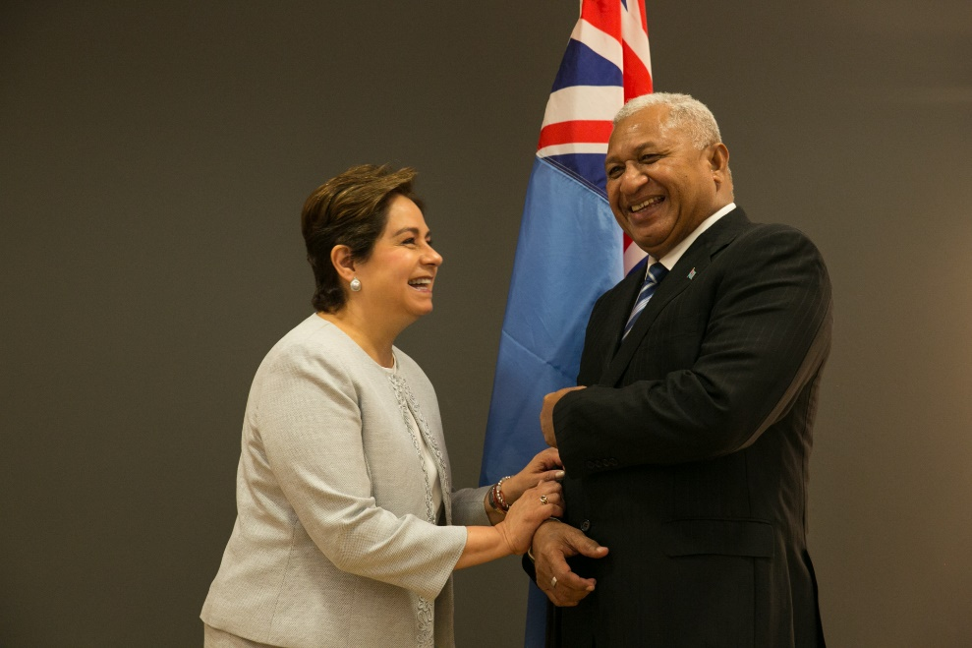
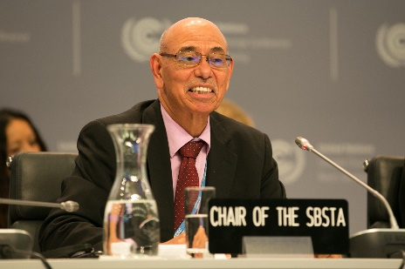
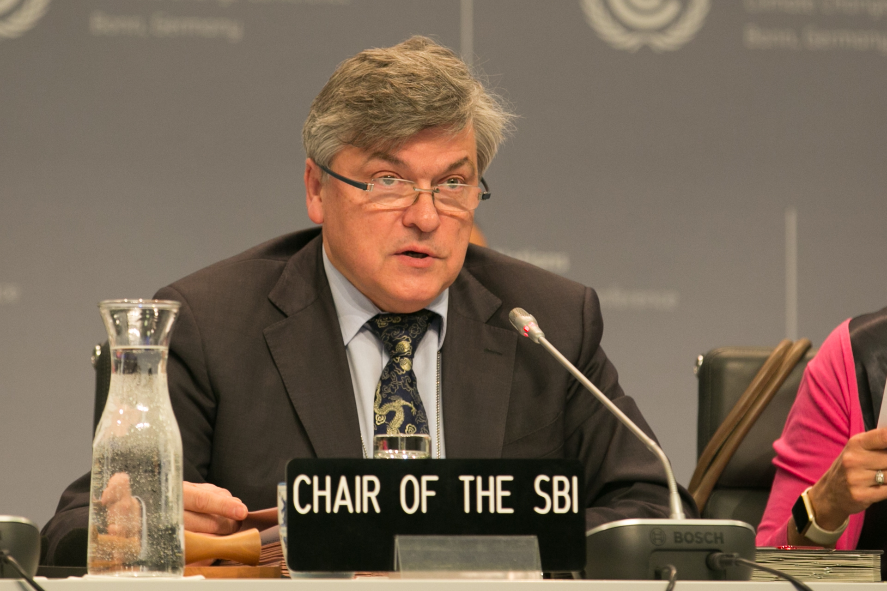
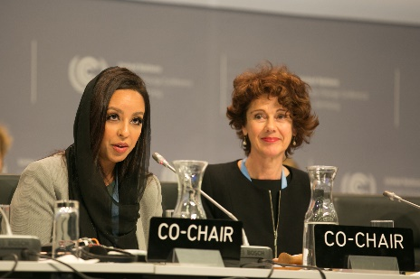
Also keep an eye out for…
UNFCCC secretariat
COP/CMP/CMA President
SBI Chair and SBSTA Chair
Observer organisations
Photos by IISD/Kiara Worth

Slide 22
What to expect from different meetings
Formal meetings
Plenary: open to all, including observers; where Groups and parties deliver statements, and decisions are formally adopted; interpretation available
Contact groups: take place in smaller settings; where decision texts are negotiated; interpretation not available
Informal meetings
Informal consultations / drafting groups: similar to contact groups, but not necessarily leading to drafting a decision
Coordination: for Groups to strategize and develop common positions
Bilaterals: short meeting with another Party/Group to clarify positions and interests, find common ground

Slide 23
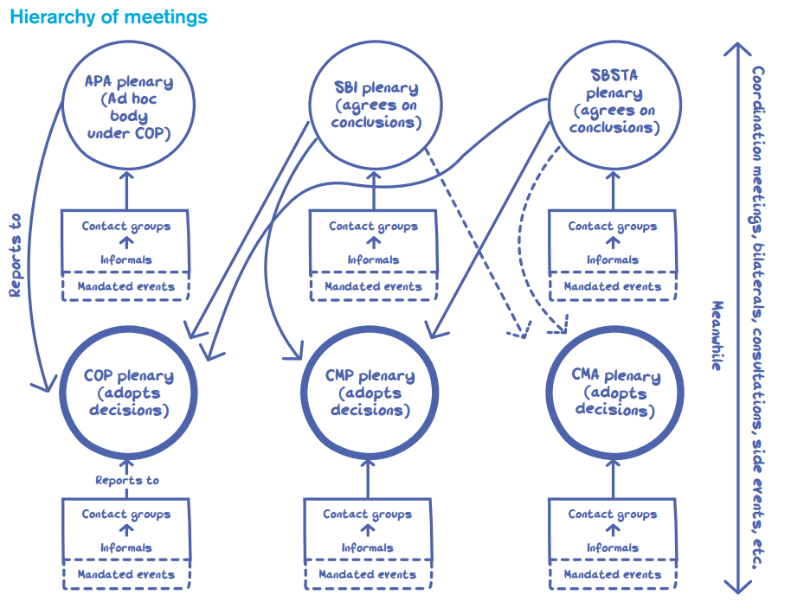

Slide 24
What does this mean for Africa
What actions need to be undertaken by
the world
Africa
(emissions, resilience)
What is the support required
Africa’s message to the world
My role as a negotiator, how to frame message

