Slide 1

ecbi
Finance for the Paris Climate Compact
The role of earmarked (sub-) national contributions
2015 ecbi Oxford Seminar
Benito Müller
Director ecbi
european capacity building initiative
initiative européenne de renforcement des capacités
for sustained capacity building in support of international climate change negotiations
pour un renforcement durable des capacités en appui aux négociations internationales sur les changements climatiques

Slide 2

Enhanced Direct Access to Multilateral Funds
National Climate Fund (NCF)
Accredited with the GCF both as funding entity and intermediary
Governed by the National Governing Body (incl. NDA representation)
Local Provincial National International
Adaptation
Mitigation
NCF
Project Implementing Entity
Large Executing Entity
Medium/Large Project/Programme
Programme Implementing Entity
Micro/Small/Medium Executing Entity (MSME)
Micro/Small Project/Programme

Slide 3
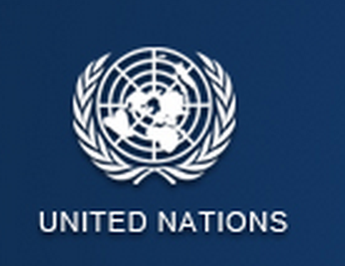
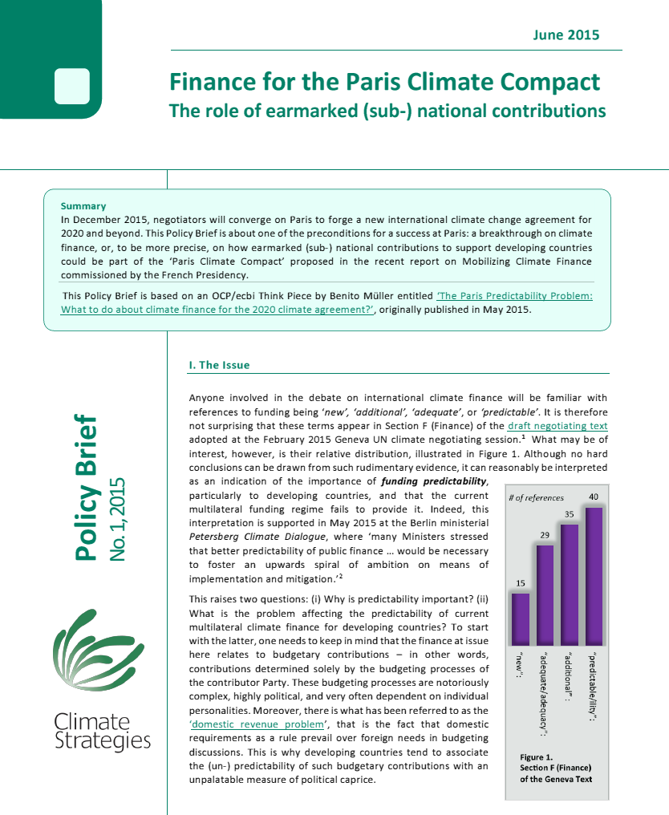

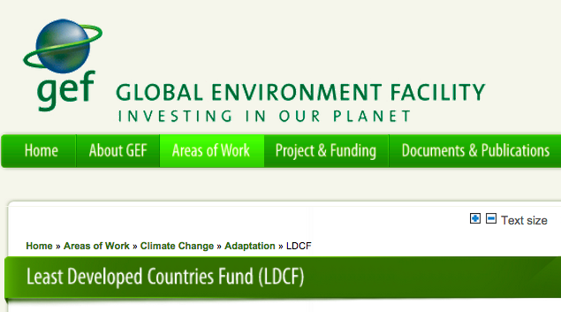
Enhanced Direct Sourcing of Multilateral Funds
EFFORTS OF NON-STATE ACTORS
Part III, §52. Efforts of subnational and local governments, sub-regional entities and the private sector to be recognized.
Secretary-General's Climate Change Support Team (CCST)
Executive Office of the Secretary-General (EOSG)
(LDCF as institutional capacitator?)

Slide 4




Enhanced Direct Sourcing of Multilateral Funds
New York
Massachusetts
California
Climate Action Secretariat
Cabinet du premier ministre

Slide 5
ecbi
european capacity building initiative
initiative européenne de renforcement des capacités
Finance
2015 ecbi Oxford Fellows Colloquium
Benito Müller
Director ecbi
for sustained capacity building in support of international climate change negotiations
pour un renforcement durable des capacités en appui aux négociations internationales sur les changements climatiques

Slide 6
ACTIONS IN THE PRE-2020 PERIOD
§ 28 Developed country Parties provide: Synthesized biennial submissions on their updated strategies and approaches to scaling up climate finance from 2014 to 2020, including quantified forward-looking information on the expected level of funding to be provided
Is this sufficient or do we need additional assurances with regard to the $100bn
Notes:
The key question: How?
How, in particular, could one ensure,
in particular [B.ii]?
Have all DCPs provide thematic lists with geographic destinations of their thematic pledges.
What if the aggregates are not balanced?

Slide 7
“So tell me what you want, what you really, really want!”
a process for periodically determining short-term needs-based aggregate target envelopes (‘short-term collective goals’) of climate finance to be provided by DCPs to ERPs through the Financial Mechanism, and a longer term indication of the evolution of these envelopes.
a ‘pledging process’ for DCPs to periodically make individual, short-term nationally determined binding pledges for public sector climate finance that
taken together comply with the applicable short-term collective goal;
when disbursed, respect a thematic and geographical balance.

Slide 8
Part Three: Provisions whose placement requires further clarity
GREEN CLIMATE FUND
§66. The GCF acting as the main operating entity of the Financial Mechanism for the implementation of this agreement shall be strengthened by ensuring predictable, sustainable and adequate resources, including through the following resources as follows:
a. Developed country Parties to provide a list of specific [contributions/pledges] reflecting the required share of climate finance to be provided to the GCF, …
The GCF replenishment shall be based on a specific financial target linked to the overall financial goal,
GCF/B.08/16: Annex II: Policies for contributions
Resource mobilization approach
d) Trigger for formal replenishment process: Once the Fund’s cumulative funding approvals exceed 60 per cent of the total contributions, confirmed by fully executed contribution agreements/ arrangements, received during the IRM, the Fund will initiate a formal replenishment process. The IRM participants envisage that this is likely to occur by end-June 2017;
Notes:
GCF/B.08/16: Annex II: Policies for contributions
Resource mobilization approach
d) Trigger for formal replenishment process: Once the Fund’s cumulative funding approvals exceed 60 per cent of the total contributions, confirmed by fully executed contribution agreements/ arrangements, received during the IRM, the Fund will initiate a formal replenishment process. The IRM participants envisage that this is likely to occur by end-June 2017;

Slide 9
Replenishments of the Financial Mechanism: Core finance contributions?
I. Replenishment Finance
Establishment of a process of Replenishment for the Financial Mechanism (GCF, LDCF, SCCF, AF)
Interpret the ‘short-term collective goals’ as envelopes for the periodic (5-year) replenishment of the funds under the Financial Mechanism (GCF, LDCF, SSCF, AF).
Use a needs-based dynamic process to determine every five years the envelope for the next pledging round, and an indicative one for the one after (to provide some predictability).
Use the pledging rounds for these replenishments as the pledging process [B], resulting in contractually binding contributions (thus implementing a ‘commitment to commit legally!’).
II. Other Finance (non-replenishment)
Use a parallel (Part III §46) process to communicate any other individual financial support to be made available or required in the next period

