Slide 1
ecbi
european capacity building initiative
initiative européenne de renforcement des capacités
Adaptation in the 2015 Agreement
Operationalising the Global Goal for Adaptation
Xolisa Ngwadla
Council for Scientific and Industrial Research (CSIR), South Africa
for sustained capacity building in support of international climate change negotiations
pour un renforcement durable des capacités en appui aux négociations internationales sur les changements climatiques

Slide 2
GGA: context
The global goal for adaptation operationalise the view by AMCEN and CAHOSCC that adaptation is priority for Africa and should receive equal treatment as mitigation, and be at the centre of the Agreement
The legal basis is the objective of the Convention (Art 2), and commitments (Art 4), and builds on previous decisions under the CoP, particularly 1/CP.16
It provides for a further elaboration and codification of adaptation in the post 2020 period, by defining
projected impacts and costs,
planning and implementation,
adaptation support,
intl. cooperation, and
assessment for adequacy

Slide 3
GGA: Operationalisation in the agreement
 | Adaptation element in the agreement (Articles) | INDC information for developed country | INDC for developing country
Projected impacts and costs | assessment of aggregate adaptation needs based temperature goal and NAPs | basis for projection of global adaptation needs, methodology & assumption | projected impacts and costs, methodology used and assumptions
Adaptation planning and implementation | guidelines for NAPs; recognition of investments by developing countries | sectors, geographies, delivery mechanism of support | programmes-projects envisaged during a cycle/ period
Adaptation support, finance, technology and CB | process of inscribing support and quantum of support for adaptation | Type, quantum of support, timelines, assumptions, vs needs | reporting on support received, country, sector, geography, type
International cooperation | recognition of cooperative initiatives facilitated and supported by any Party, | description of envisaged initiative, level of support provided | description of envisaged initiative, level of support provided/received
Assessment for adequacy | ex ante assessment (support vs needs), ex post review of implementation (recognition) | N/A | N/A

Slide 4
GGA: adaptation needs GGA
Step 1: Based on an ensemble of Regionally Downscaled Models, project the probability of incidence of climate impacts, consistent with a SRES/RCP scenario for 0ºC, 1ºC, 2ºC, 3ºC in the developing country regions of the world
Step 2: Computation of probability density curves for the impacts under each of the temperature scenarios for the duration of the commitment period, as such reflecting the median magnitude of impacts during the period
Step 3: From records establish an average costs per sector for specific regions, which in association with the probability density curves presents a cost curve, of which the sum of costs for the impacts for a region/country during a commitment cycle reflect incremental adaptation needs
Step 4: The median costs from the climate costs + adaptation costs from NAPs and NAPAs based on the resultant temperature scenario therefore reflect the GGA for the commitment period, which is a global obligation in respect of supporting developing country adaptation action

Slide 5
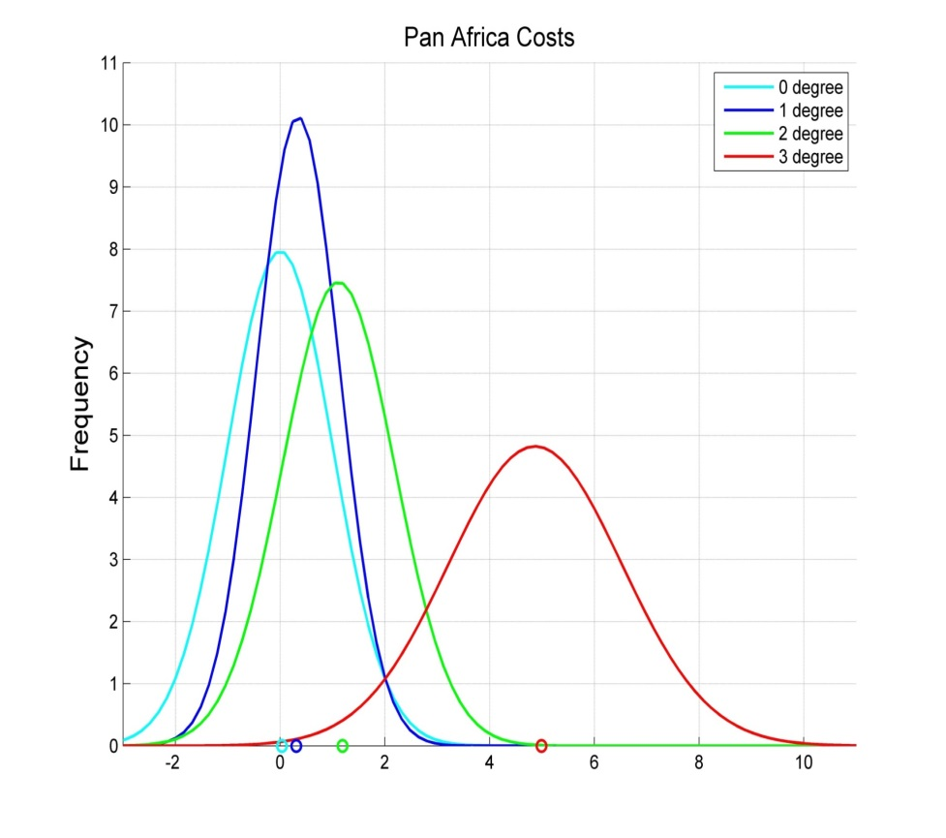
THANK YOU

Slide 6
