Slide 1
ecbi
european capacity building initiative
initiative européenne de renforcement des capacités
Technology development and transfer
Brianna Craft
IIED
for sustained capacity building in support of international climate change negotiations
pour un renforcement durable des capacités en appui aux négociations internationales sur les changements climatiques

Slide 2
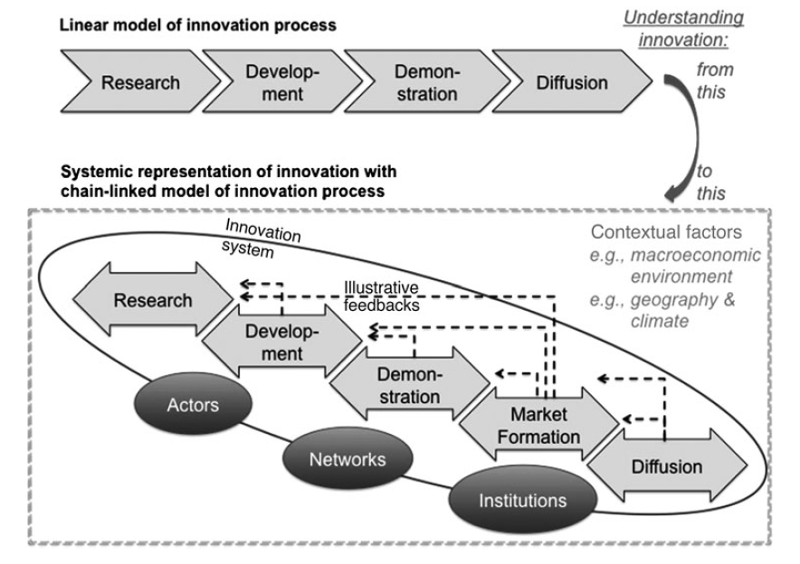
What is technology transfer?
Technology transfer is “a broad set of processes covering the flows of know-how, experience, and equipment for mitigating and adapting to climate change amongst different stakeholders” (IPCC, 2000: 3).
‘Technology’ is more than hardware - “a broad set of processes covering the flows of know-how, experience, and equipment for mitigating and adapting to climate change […]” (IPCC, 2000: 3).
‘Transfer’ is not the mere sale or lease of goods - it comprises the process of learning to understand, utilise, and replicate technology, including the capacity to choose it and adapt it to local conditions and to integrate it with indigenous technologies (IPCC, 2000).
Image source: Gallagher et al. 2012
Notes:
The Convention took onboard the IPCC’s definition of technology transfer
The UNFCCC observed a change of terminology at COP 15 in 2009 when parties began to refer to ‘technology
development and transfer’ rather than merely ‘technology transfer’ (Decision 1/CP.15).
In practice, the UNFCCC’s definition of a ‘successful transfer’ excludes the mere sale or lease of goods and includes the transfer of sufficient knowledge to successfully install, operate and maintain any equipment that embodies a technology new to a country.
Technology transfer refers to the actions accompanying the integration of environmentally sound technologies into nations where those specific technologies had not before existed.

Slide 3
A brief history
1992, Convention
Articles 4.3, 4.5, 4.7 and 4.9 relate to technology transfer
1995, COP 1
1998, COP 4
Berlin Mandate establishes a technology transfer projects inventory; investigates technology transfer financing; establishes networks of technology centres; and identifies needed adaptation technologies
Buenos Aires Plans of Action calls on industrialised countries to provide lists of publicly owned environmentally sound technologies
2001, COP 7
The COP agreed to a ‘technology framework’ that covered five key themes for action: technology needs assessments (TNAs); technology information; enabling environments; capacity building; and mechanisms for technology transfer
Bali Action Plan mandates a focus on key elements of long-term cooperation, including technology transfer
2008, COP 14
Poznan Strategic Program on technology transfer (PSP) established as a step towards scaling up the level of investment in technology transfer
Technology Mechanism established to facilitate the implementation of nationally determined mitigation and adaptation technology activities
Developing countries called to submit reports outlining their technological needs
All Parties called to stimulate private sector investment; identify projects and programmes on cooperative approaches; and engage in a consultative process to consider specific issues and questions
The framework launched a Technology Transfer Information Clearing House (TT:CLEAR), an information centres network, and lists needed capacity building activities
Parties agree to undertake an assessment of the gaps and barriers to the provision and access to financing for technology transfer
2015, COP 21
Paris Agreement, Article 10 relates to technology development and transfer
The Marrakesh Accords establishes an Expert Group on Technology Transfer (EGTT) which identifies ways to advance technology transfer activities and prepares a handbook on TNA methodologies
2007, COP 13
PSP’s funding window of US$50 million has three objectives: assisting developing countries to conduct TNAs; completing a series of pilot priority technology projects; and disseminating UNFCCC experience and successes
2010, COP 16
The mechanism is composed of two branches: a Technology Executive Committee (TEC) and a Climate Technology Centre and Network (CTCN)

Slide 4
Three issues to consider
New vision and framework
Technology Mechanism
Funding for implementation

Slide 5
Vision and framework
Paris Agreement
Article 10.1 – “Parties share a long-term vision on the importance of fully realizing technology development and transfer in order to improve resilience to climate change and to reduce greenhouse gas emissions.”
Article 10.4 – “A technology framework is hereby established to provide overarching guidance to the work of the Technology Mechanism in promoting and facilitating enhanced action on technology development and transfer in order to support the implementation of this Agreement, in pursuit of the long-term vision referred to in paragraph 1 of this Article.”
Issues to consider
What does the long-term vision mean in practical terms?
How is progress measured?
What guidance should be provided to the Technology Mechanism?

Slide 6
Technology Mechanism
Paris Agreement
Article 10.3 – “The Technology Mechanism established under the Convention shall serve this Agreement.”
Issues to Consider
How can the current actions of the Technology Mechanism be improved?
How can the Technology Mechanism best work to implement the outcomes of the TNAs and TAPs?
How to can the TEC and CTCN best coordinate to improve implementation?
Image source: UNFCCC, 2016

Slide 7
Funding for implementation
Paris Agreement
Article 10.6 – “Support, including financial support, shall be provided to developing country Parties for the implementation of this Article, including for strengthening cooperative action on technology development and transfer at different stages of the technology cycle, with a view to achieving a balance between support for mitigation and adaptation. The global stocktake referred to in Article 14 shall take into account available information on efforts related to support on technology development and transfer for developing country Parties.”
Decision paragraphs 66 and 69 call for a periodic assessment of the effectiveness and adequacy of support to the Technology Mechanism.
Issues to consider
What information is needed to periodically assess the effectiveness and adequacy of support to the Technology Mechanism?
In the short term, how can we initiate and encourage links between the Technology Mechanism and the Financial Mechanism?
In the long term, where shall the specified financial support come from and flow through (e.g. the GCF, the LDCF, etc.)?
Notes:
Article 10.6 states that support — including financial support — shall be provided to developing country parties. This support will be used to strengthen cooperative action on technology development and transfer at different stages of the technology cycle, with a view to achieving a balance between support for mitigation and adaptation. The global stocktake (referred to in Article 14) will also take into account available information on support for technology development and transfer.
Transparency, Article 13
9. Developed country Parties shall, and other Parties that provide support should, provide information on financial, technology transfer and capacity-building support provided to developing country Parties under Articles 9, 10 and 11.
10. Developing country Parties should provide information on financial, technology transfer and capacity-building support needed and received under Articles 9, 10 and 11.

Slide 8
What happens next?
COP 22, Marrakech, November 2016
SBSTA to elaborate the technology framework established in the Paris Agreement. This process will make recommendations for consideration and adoption at the CMA's first meeting.
SBI to elaboration modalities for the periodic assessment of the effectiveness and adequacy of support to the Technology Mechanism.
Standing agenda items:
Joint annual report of the TEC and the CTCN
Poznan strategic programme on technology transfer
Linkages between the Technology Mechanism and the Financial Mechanism
The TEC meets independently of the UNFCCC sessions. Their next meeting will be held 6 - 9 September. The Advisory Board of the CTCN will likely also meet in September. More info is available on TT:CLEAR.
Notes:
12th meeting of TEC – Duduzile (Swaziland) is Chair and Michael Rantile (Sweden) is vice chair. Time spent considering how TNAs, TAPs and other tech issues can be coordinated with NDCs. Nearly all non-Annex 1 parties mentioned tech in their NDCs. At the end of the meeting the TEC approved a three year rolling workplan. Work will be conducted by six task forces: Mitigation; Adaptation; Finance; Innovation and Research Demonstration and Development (RD&D); TNA; and Emerging and Cross-Cutting Issues.
Climate Technology Centre & Network (CTCN). The TEC works closely with the CTCN, and both the director and the head of the advisory board were present for much of the TEC meeting. The TEC heard presentations from both the Chair of the CTCN Advisory Board (CTCN AB) and the Director of the CTCN. CTCN has had 98 requests for technical assistance from 51 parties. The CTCN network is approaching 150 members.
Next TEC Meeting. The next meeting will be held the first week in September. The secretariat will provide exact dates pending room availability.

Slide 9
Helpful websites
Paris Agreement - http://unfccc.int/paris_agreement/items/9485.php
UNFCCC website - http://unfccc.int/2860.php
TT:CLEAR - http://unfccc.int/ttclear/pages/home.html
References
Abeysinghe, Achala, Brianna Craft, and Janna Tenzing. 2016. “COP21 and the LDCs: Analysing COP21 outcomes from LDC positions.” IIED issue paper. (Forthcoming)
Craft, Brianna, Karma Tshering, and Fred M. Onduri. 2015. “Technology development and transfer, the Least Developed Countries and the future climate regime: Considerations for the post-2020 international response to climate change.” LDC paper series. Available here - https://ldcclimate.wordpress.com/ldc-paper-series/
Gallagher, Kelly S., Arnulf Grubler, Laura Kuhl, Gregory Nemet, and Charlie Wilson. 2012. “The Energy Technology Innovation System.” The Annual Review of Environment and Resources 37(2012): 137-162. DOI: 10.1146/annurev-environ-060311-133915.
Intergovernmental Panel on Climate Change (IPCC). 2000. “Methodological and Technological Issues in Technology Transfer: Summary for Policymakers.” Special Report of Working Group III. ISBN: 92-9169-112-7.
LDC Group. 2016. “LDC review of the Paris Agreement and its adopting decision 1/CP.21.”
United Nations Framework Convention on Climate Change (UNFCCC). 2016. “Essential Background.”http://unfccc.int/ttclear/misc_/StaticFiles/gnwoerk_static/NAD_EBG/707419c115344cd68519ecbb18b9065e/93367e2039ca4f6b80d09c1a4589e17e.png

